Slide 1
NETW211 Final Project
Created by: Jeremy Duncan

Slide 2
Introduction
In this project, I will be demonstrating fundamental concepts of cloud computing while exploring the features Amazon Web Services (AWS) offers.

Slide 3
Concepts Covered
Section 1: Virtual Machines
Section 2: Virtual Networks
Section 3: VM Security
Section 4: Cloud Storage
Section 5: Cloud Monitoring

Slide 4
SECTION 1
Virtual Machines (VMs): aws EC2 virtual server
In section one of my project I am:
LAUNCHING THE EC2 DASHBOARD in AWS.
CONFIGURING and launcing an EC2 VIRTUAL SERVER instance in AWS.
Connecting to my EC2 instance remotely with ssh.
VERIFYING EC2 network CONNECTIVITY with various linux commands.
Terminating an EC2 instance.

Slide 5
Career Skills obtained
Section 1: Virtual Machines
experience with setting up and terminating AWS EC2 instances.
Knowledge with AWS EC2 configurations, settings, pricing plans.
experience analyzing AWS EC2 Network connectivity.

Slide 6
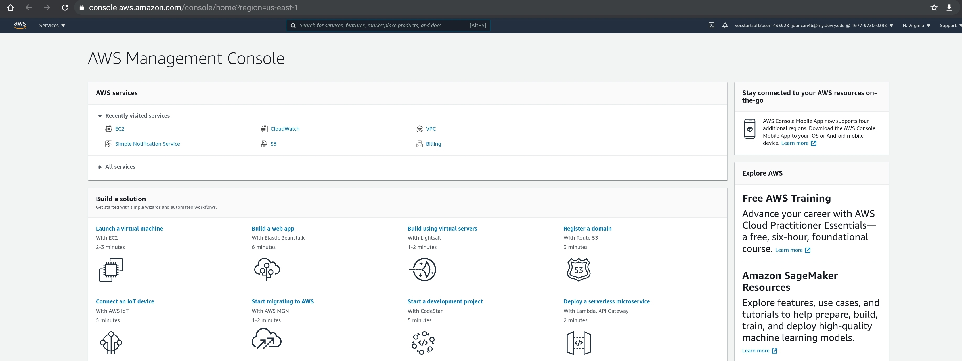
Section 1: Virtual Machines
My first step is logging into the AWS Management Console, where I’m provided many options from here.

Slide 7
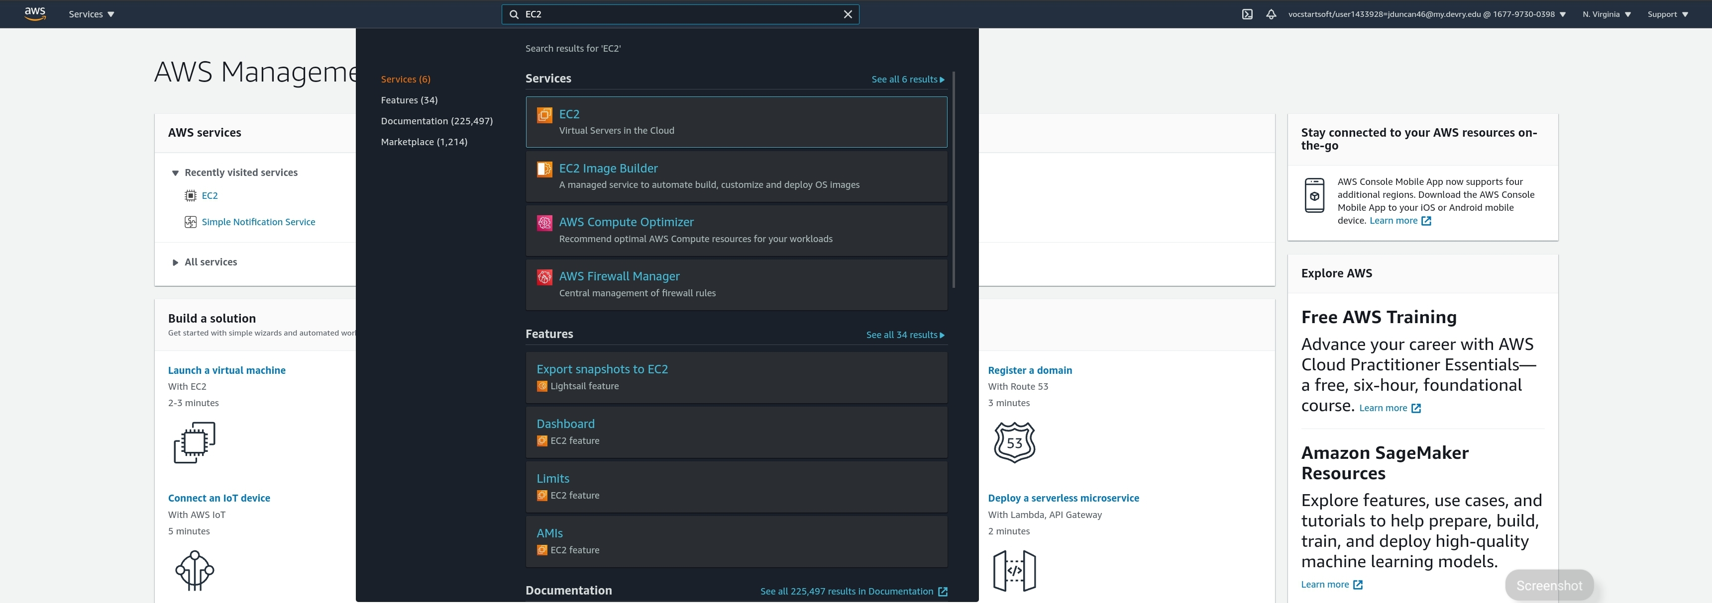
Section 1: Virtual Machines
I want to start a virtual server in the cloud, so I will be using EC2. Amazon Elastic Compute Cloud (Amazon EC2) is a web service that provides secure, resizable compute capacity in the cloud. I typed in “EC2” in the top search bar to quickly bring up the EC2 service.

Slide 8
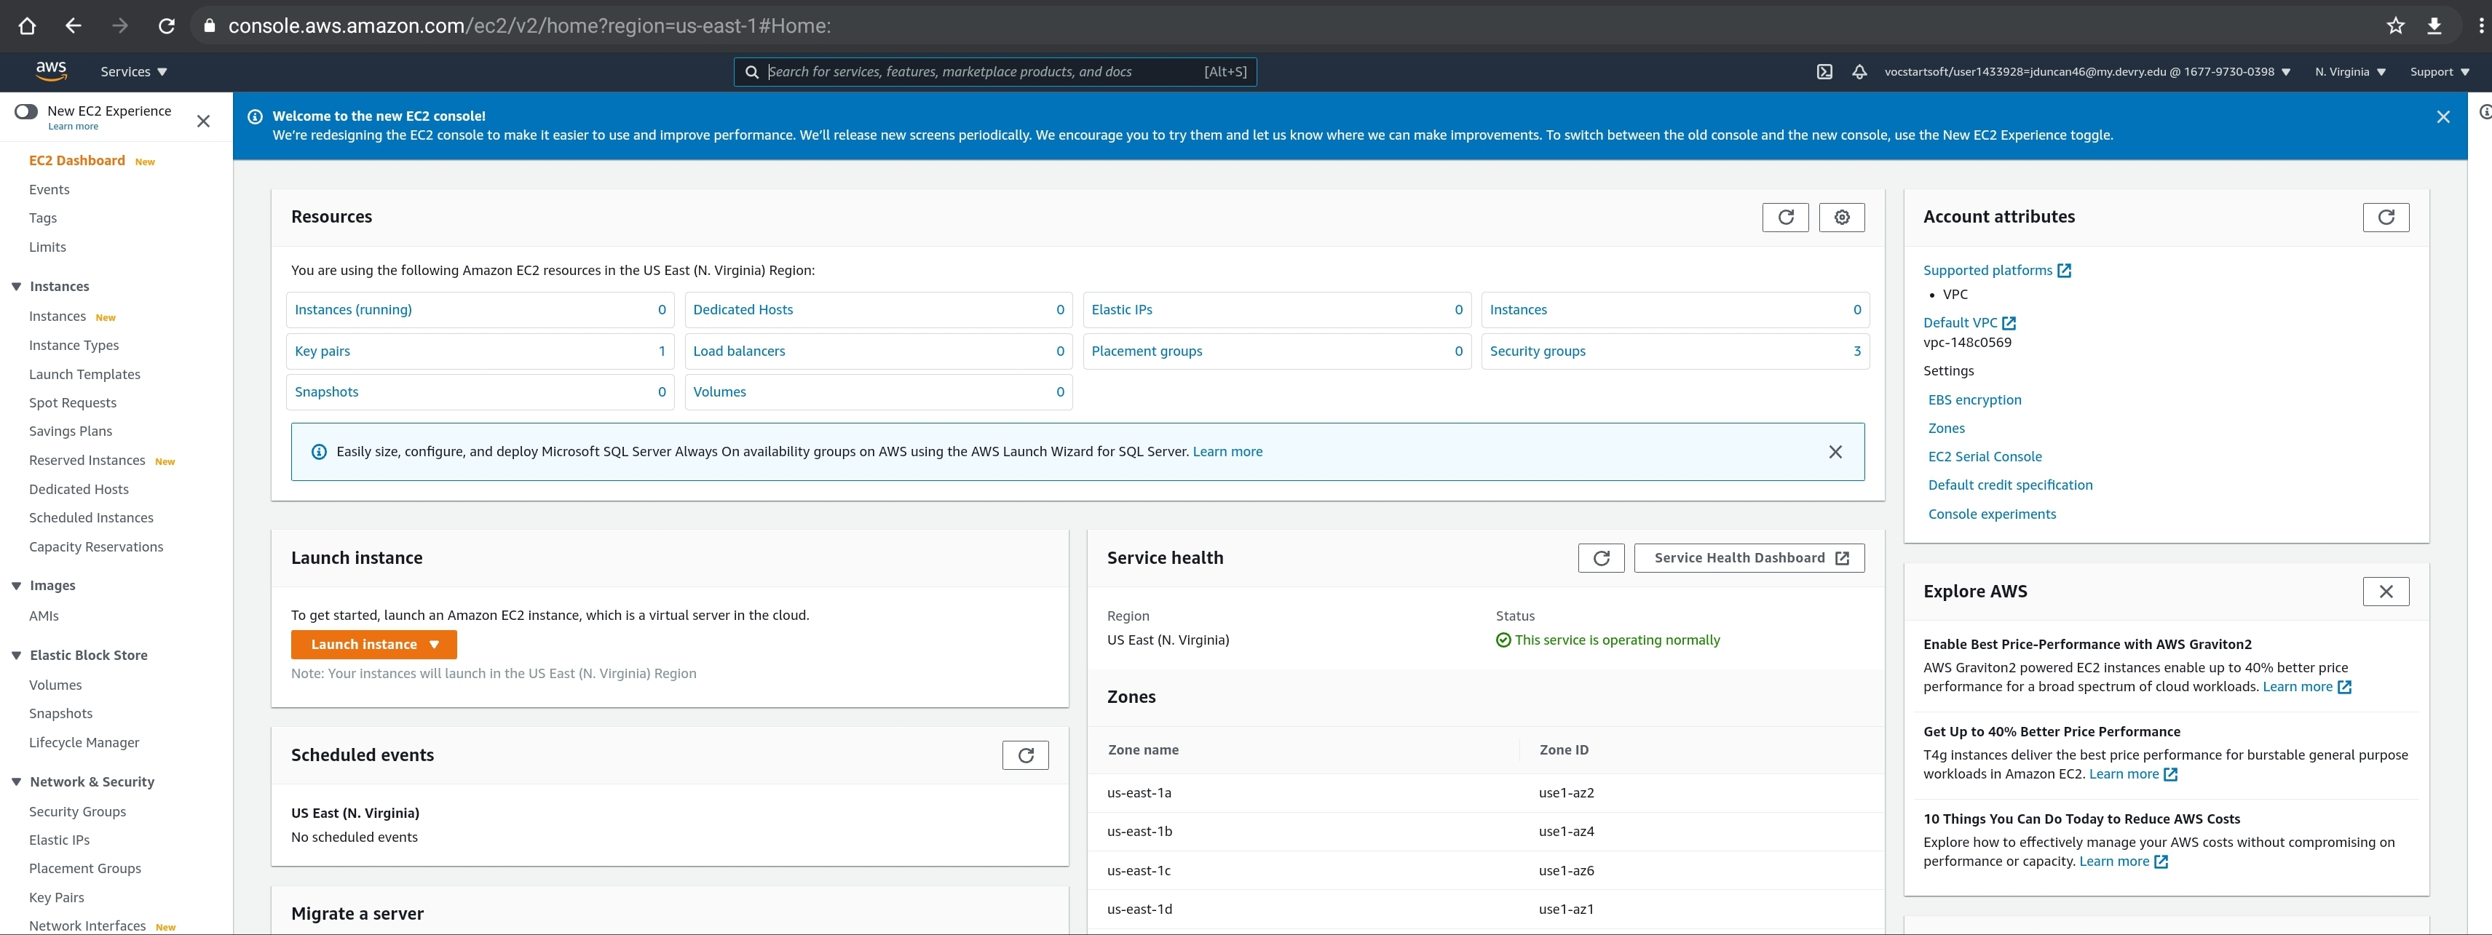
Section 1: Virtual Machines
In my next step, I selected Instances in the EC2 Dashboard menu.

Slide 9
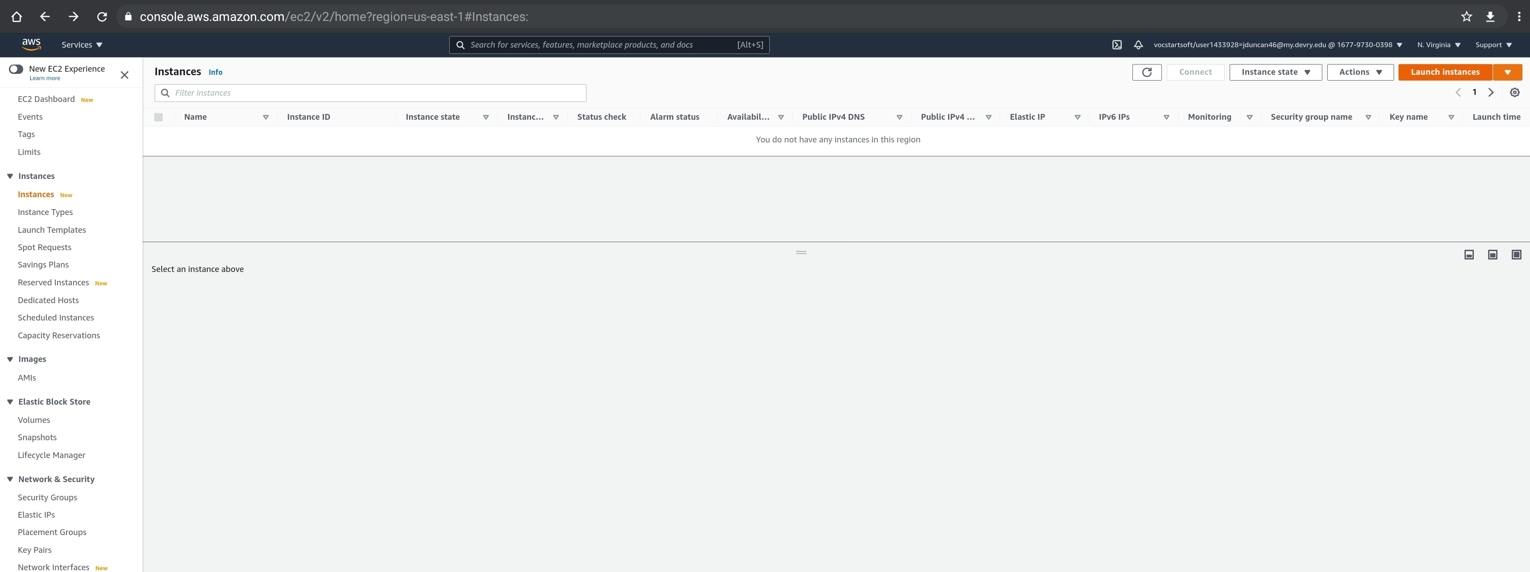
Section 1: Virtual Machines
Next I will select Launch instances.

Slide 10
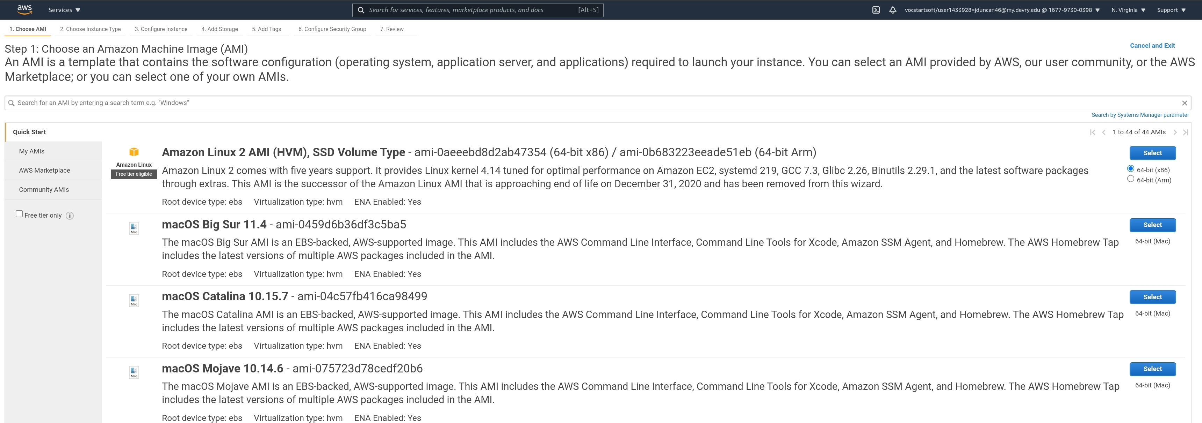
Section 1: Virtual Machines
After clicking on Launch instances, It brings you to a selection of Amazon Machine Images (AMI). These are pre-configured images that contain many different options depending on your needs. In this example I will be choosing the first choice, Amazon Linux 2 AMI.

Slide 11
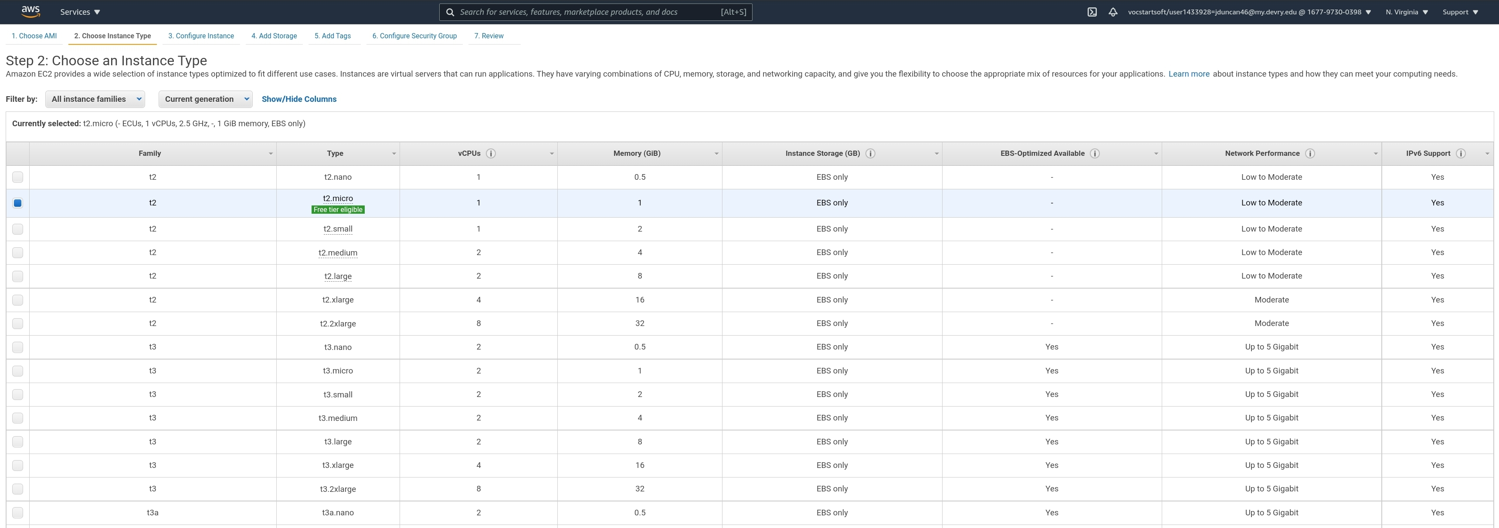
Section 1: Virtual Machines
Under Choose Instance Type I selected t2 micro for this project, which contains 1 virtual CPU, 1 GB of memory, and low network performance.

Slide 12
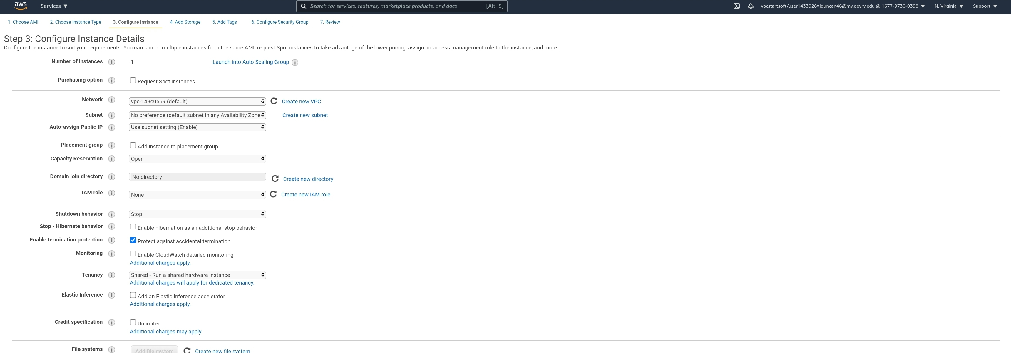
Section 1: Virtual Machines
Next, I clicked on Configure instance and selected Protect against accidental termination. This will prevent the instance I’m creating to be terminated by accident.

Slide 13
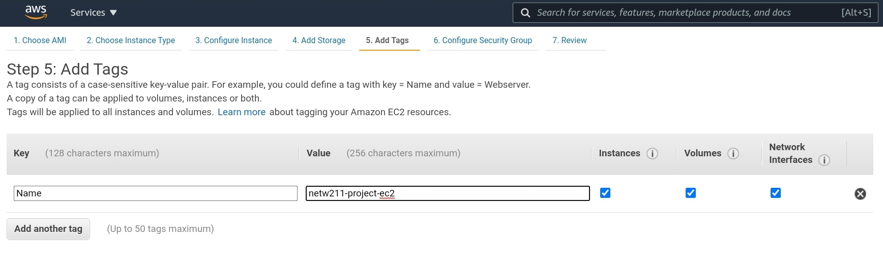
Section 1: Virtual Machines
Next, I selected Add Tags, and typed in “Name” for the Key, and “netw211-project-ec2” as the Value.

Slide 14
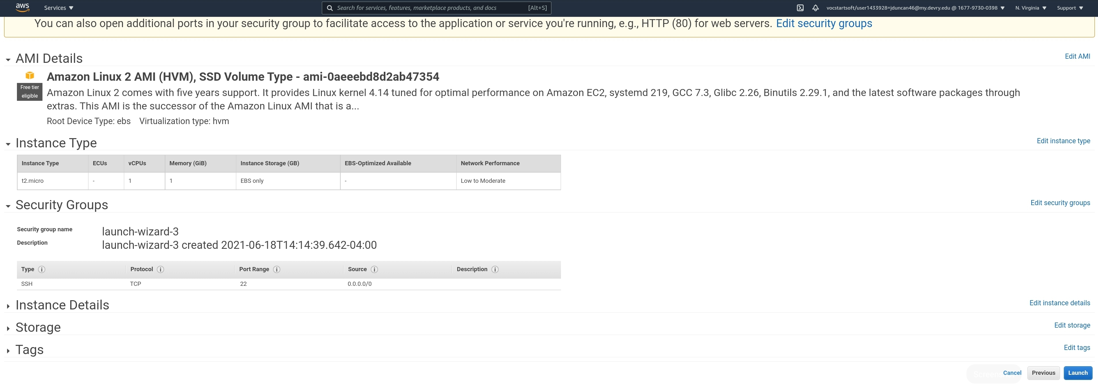
Section 1: Virtual Machines
Next, I click on Review, then selected Launch at the bottom of the page.

Slide 15
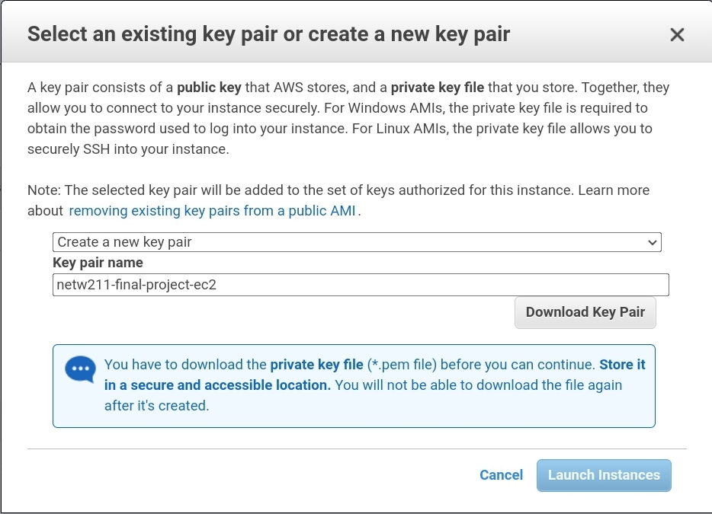
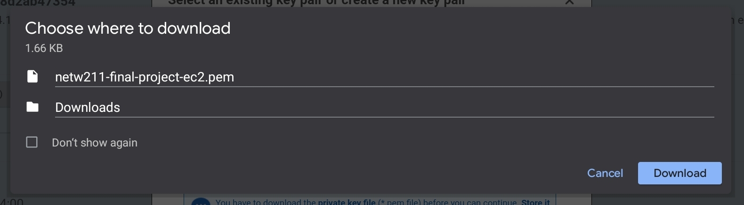
Section 1: Virtual Machines
I select Create a new key pair and under Key pair name I typed in “netw211-final-project-ec2”. Next I select Download Key Pair which prompts me if I want to download the Pem key file called “netw211-final-project-ec2.pem”. I cIick Download, then Launch instances.
1
2
3
4

Slide 16
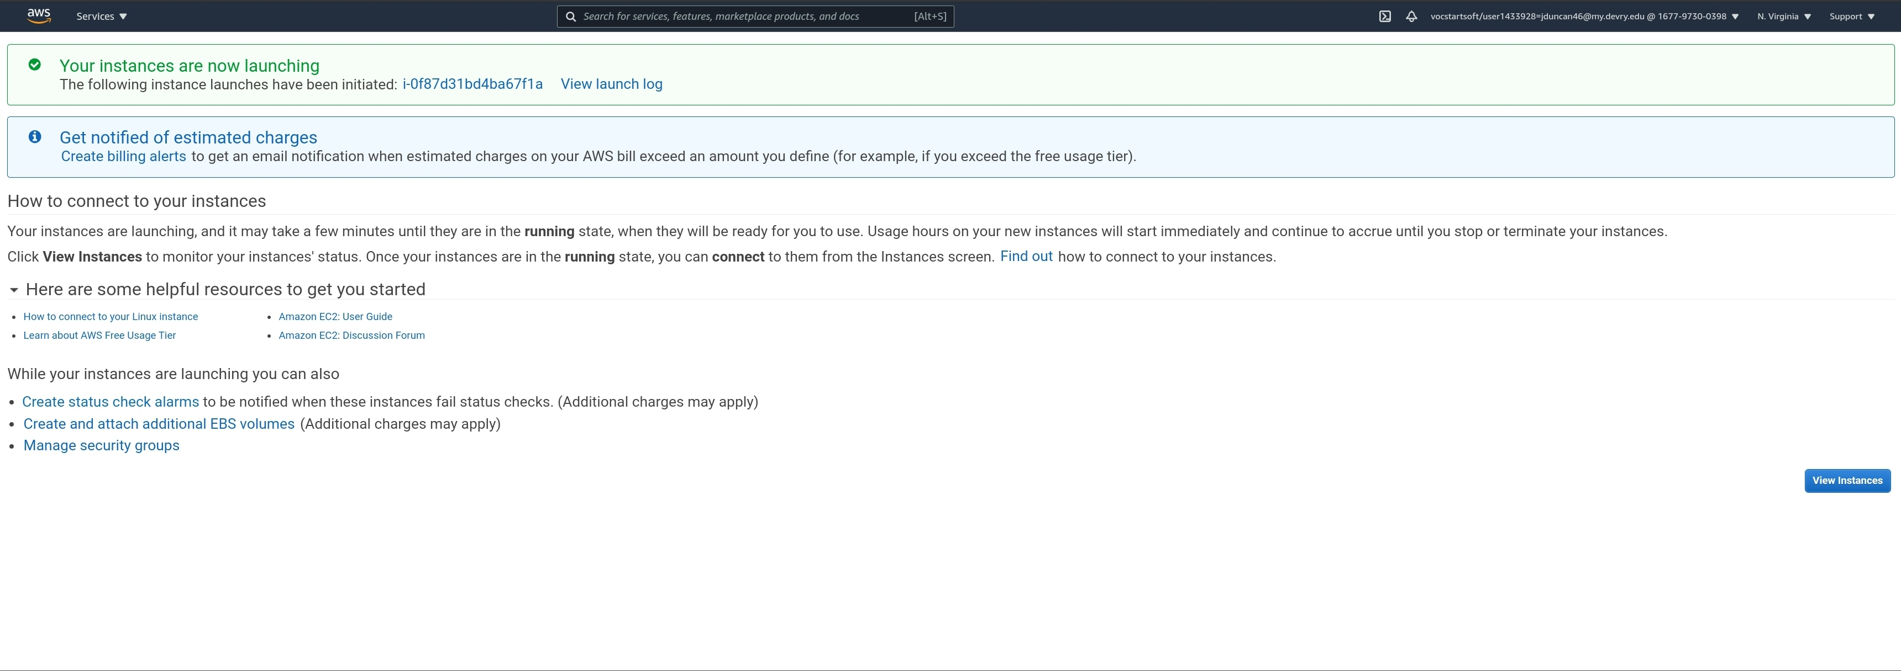
Section 1: Virtual Machines
After clicking on Launch instances, I’m notified my instance is launching and I am able to click on View Instances, which I do next.

Slide 17
Section 1: Virtual Machines
I am brought back to the Instances page, which shows the details of my newly created instance. To bring up more information on my instance, I click on the blue link under Instance ID as shown below.

Slide 18
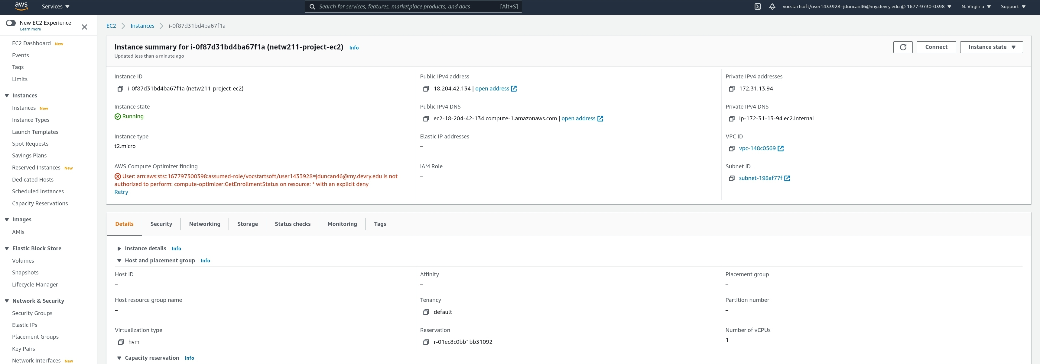
Section 1: Virtual Machines
Once I select the Instance ID, I’m brought to a summary page that displays much more information. For this project I’m interested in the Public IPv4 address and Public IPv4 DNS. Once I have that information I click on Connect.

Slide 19
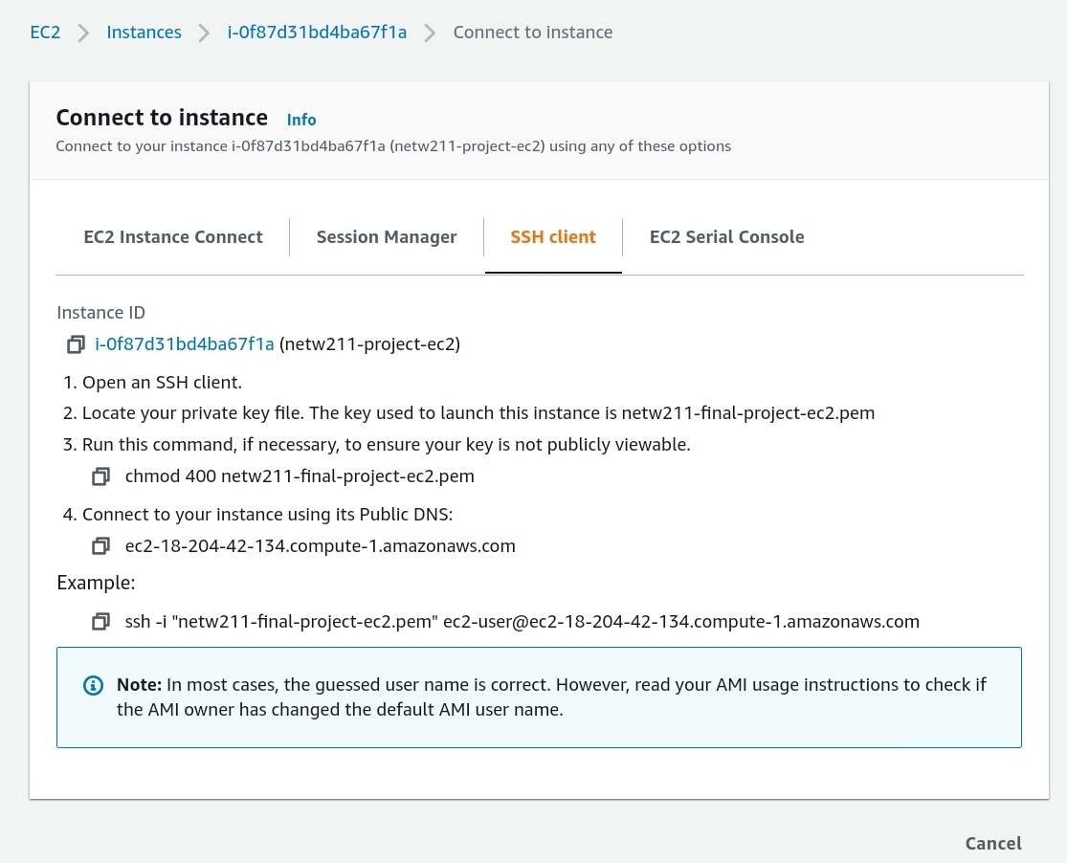
Section 1: Virtual Machines
This displays information necessary to connect using an SSH client with an example of what to type in a command prompt. It displays the required PEM file, User ID, and DNS informatin to I’ll need to connect to my instance.

Slide 20
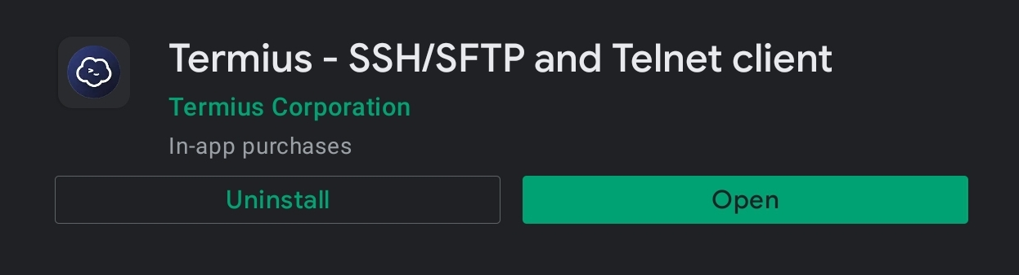
Section 1: Virtual Machines
Since I am using an Android OS to configure and complete this project, I am not using the typical Windows command prompt to test my EC2 Instance. Instead I’ll be using an Android App called “Termius” to connect into my instance for testing using Secure Shell (SSH).
SSH is a protocol used to securely connect to a remote server.

Slide 21
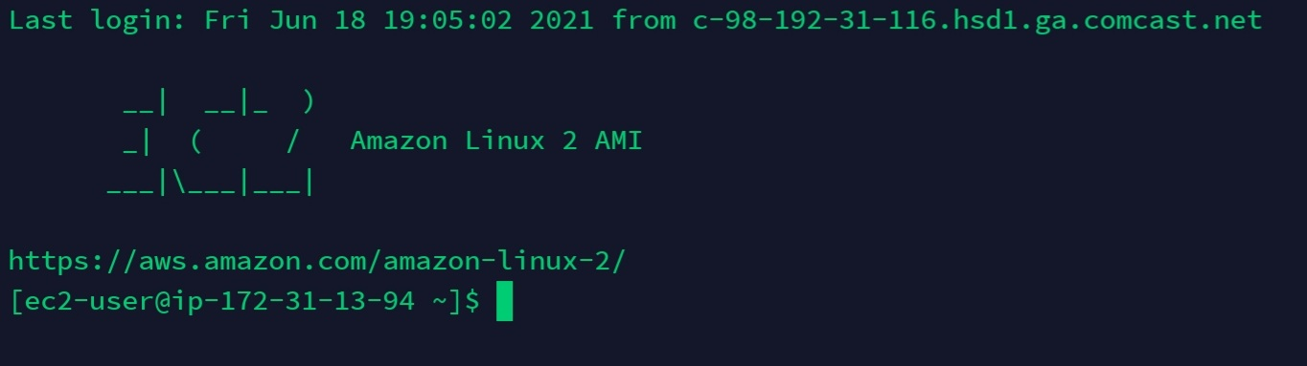
Section 1: Virtual Machines
After using the required PEM file, Username, and DNS info provided in the prior page, I am able to connect to my EC2 instance via SSH from my Android device.
User Name
Private IP

Slide 22
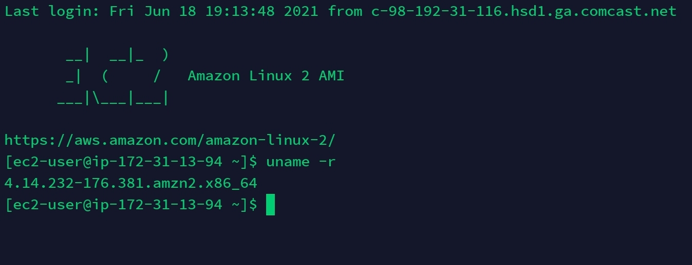
Section 1: Virtual Machines
I typed in “uname –r” to get the kernel release date.
Kernel Info

Slide 23
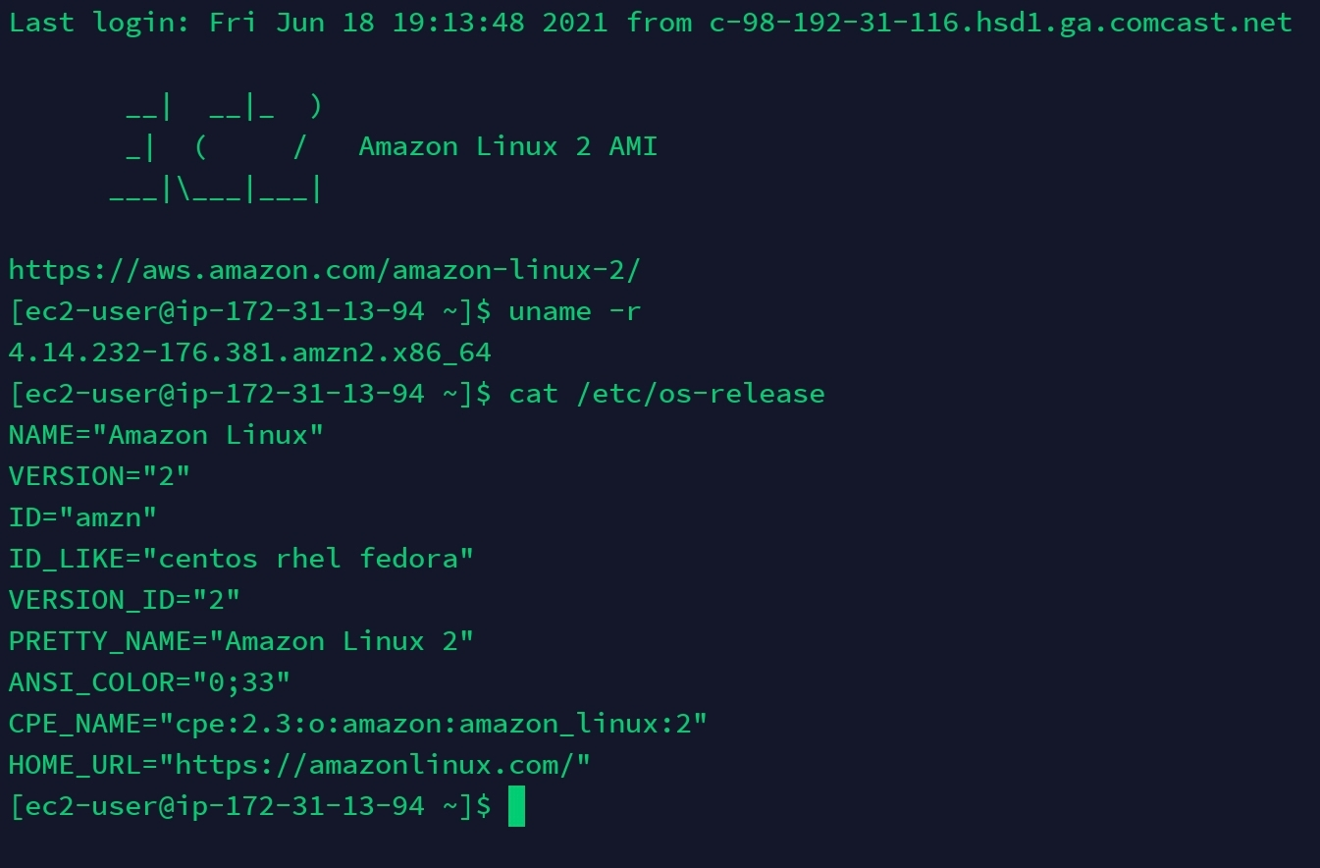
Section 1: Virtual Machines
I typed in “cat /etc/os-release” to check the OS version of Linux running on my EC2 instance.
Operating System
Information

Slide 24
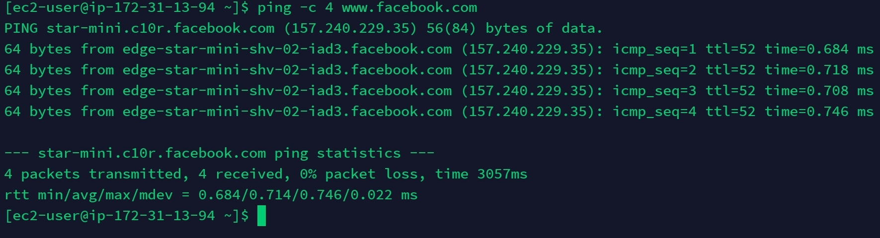
Section 1: Virtual Machines
I typed “ping –c 4 www.facebook.com” to verify my EC2 instance has a working public connection.
Successful Ping

Slide 25
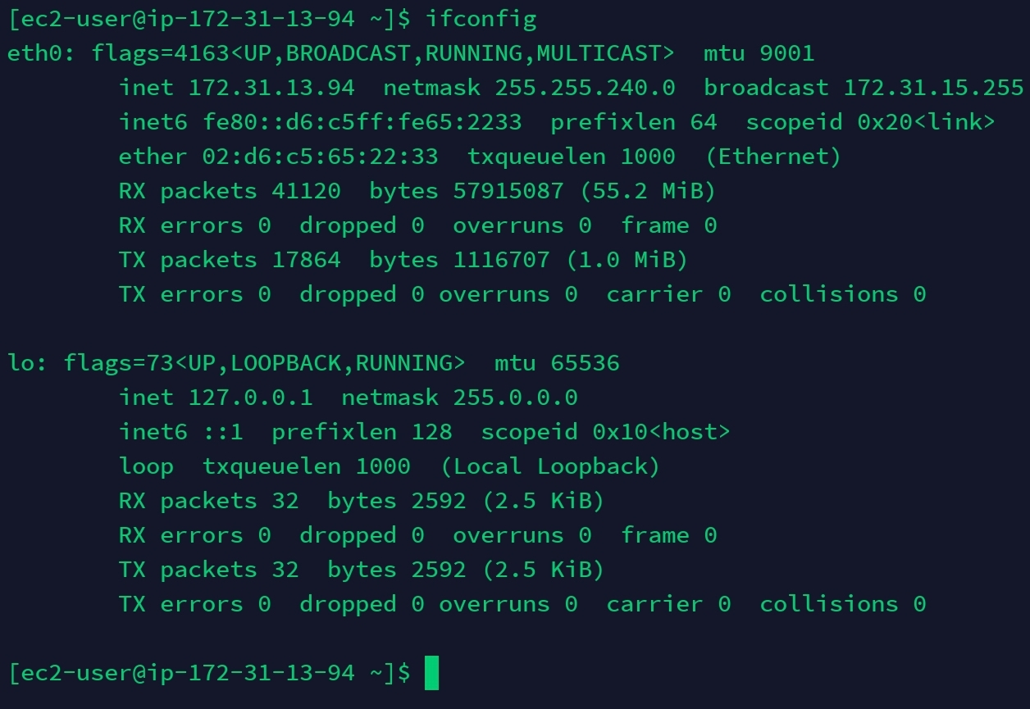
Section 1: Virtual Machines
I typed “ifconfig” to view the current network interface and private IPv4 address.
Private IPv4
Address

Slide 26
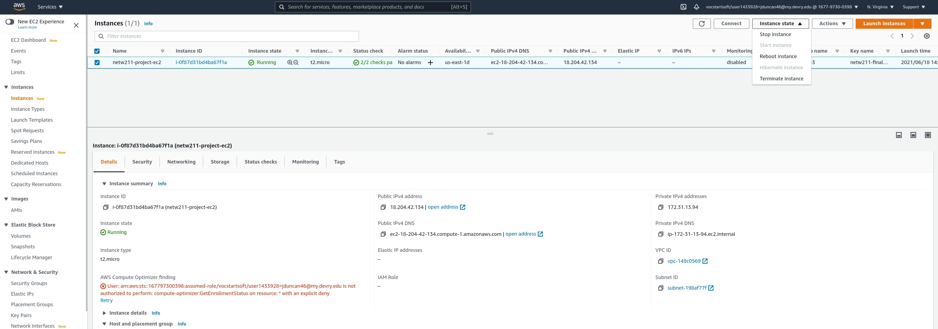
Section 1: Virtual Machines
Now that I verified my EC2 Instance was successfully launched and working, it’s time for me to terminate it. I select Terminate instance in the drop-down menu of Instance state in AWS.

Slide 27
Section 1: Virtual Machines
Since I enabled Protect against accidental termination In the EC2 configuration of my instance earlier, I get an error message saying it failed to terminate the instance.

Slide 28
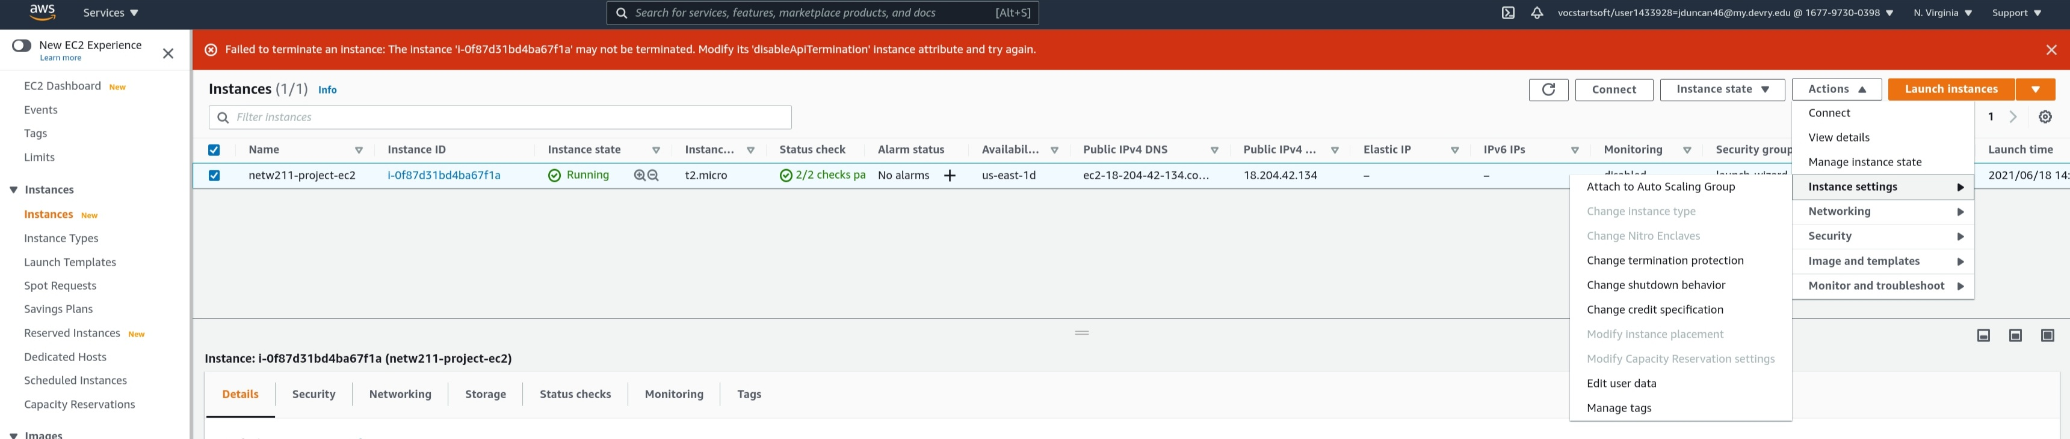
Section 1: Virtual Machines
To fix this, I have to disable termination protection. I click on Actions, then Instance settings, then Change termination protection.
1
2
3

Slide 29
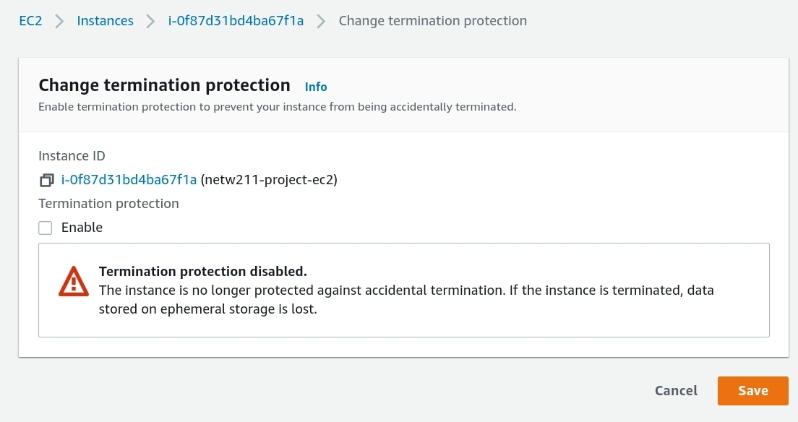
Section 1: Virtual Machines
I needed to uncheck Enable for termination protection and click Save so I can properly terminate my EC2 Instance now.

Slide 30
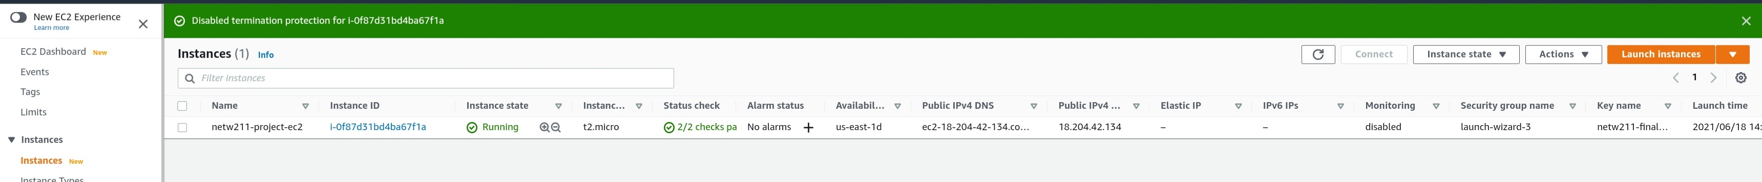
Section 1: Virtual Machines
Now that I disabled termination protection, I am notified at the top of the page.

Slide 31
Section 1: Virtual Machines
Now its time for me to try and terminate the instance again. I select Terminate instance in the drop-down menu of Instance state in AWS.

Slide 32
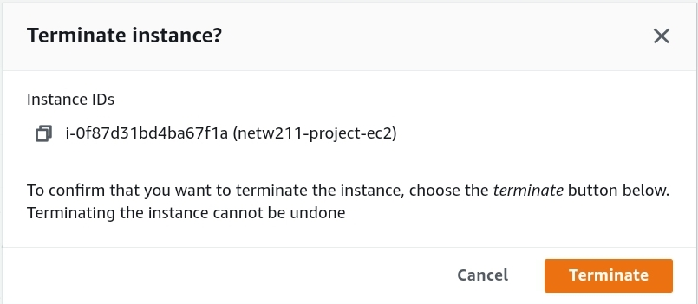
Section 1: Virtual Machines
I click on Terminate in the confirmation box.

Slide 33
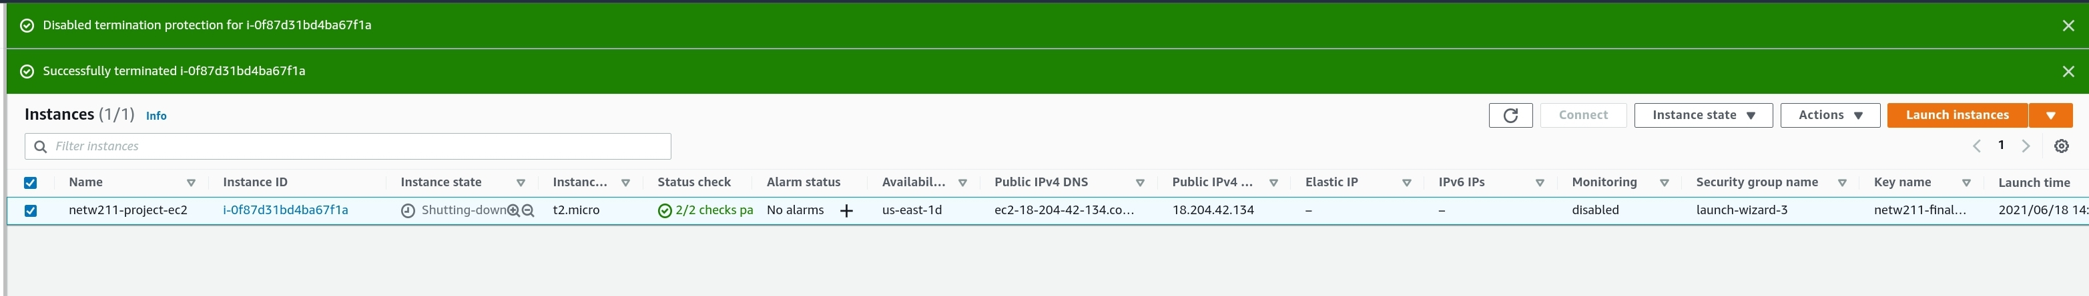
Section 1: Virtual Machines
After confirming I want to terminate my EC2 instance, I am notified it was successfully terminated at the top, and the Instance state changes to Shutting-down.

Slide 34
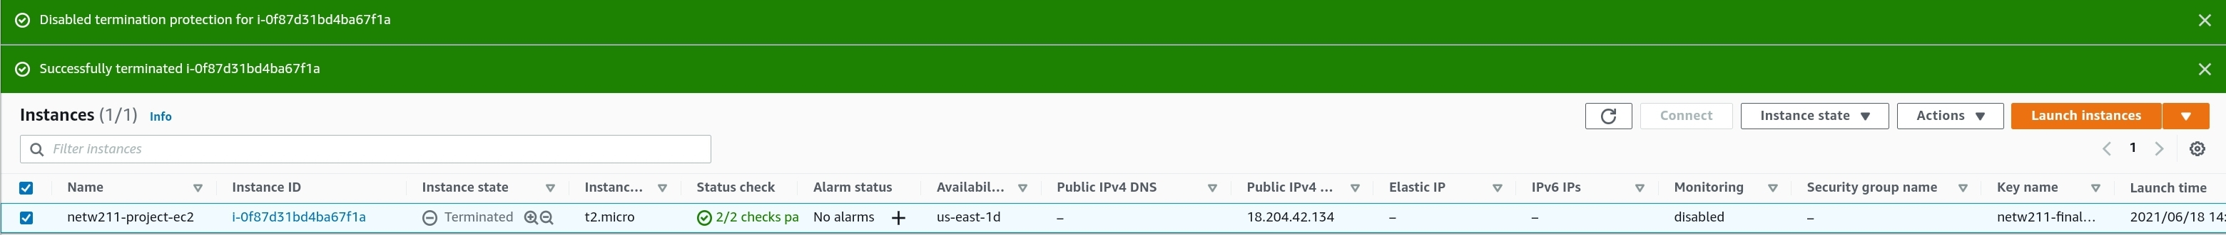
Section 1: Virtual Machines
After a few moments, the Instance state will change to Terminated as shown below.

Slide 35
Section 1: Virtual Machines
Challenge Question:
Could you locate the details of the t2.micro instance you used in this module?
How many vCPUs does it have?
How much memory does it have?
How much does it cost per hour?

Slide 36
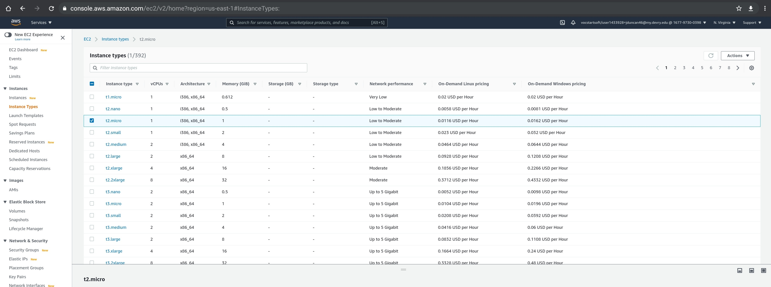
Answer:
Section 1: Virtual Machines
The t2.micro instance has 1 vCPU, 1GiB of Memory, and costs 0.0116 USD per hour (For On-Demand Linux Pricing).

Slide 37
SECTION 2
virtual networks: aws Virtual Private Cloud (VPC)
In section two of my project I am:
LAUNching a Virtual private cloud with a single subnet.
Viewing subnets and routing tables.
Adding another subnet to a vpc.

Slide 38
Career Skills obtained
Section 2: Virtual Networks
experience with setting up and terminating an AWS VPC.
Knowledge with vpc subnets and routing tables.
Ability to troubleshoot an aws vpc.

Slide 39
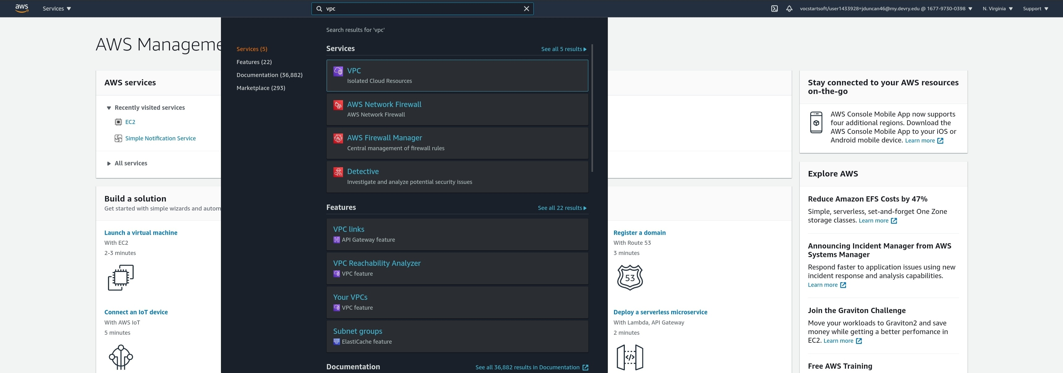
Section 2: Virtual Networks
Amazon Virtual Private Cloud (Amazon VPC) enables you to provision a logically isolated section of the AWS Cloud where you can launch AWS resources in a virtual network that you've defined.
I typed in “vpc” in the top search bar to quickly bring up the vpc service.

Slide 40
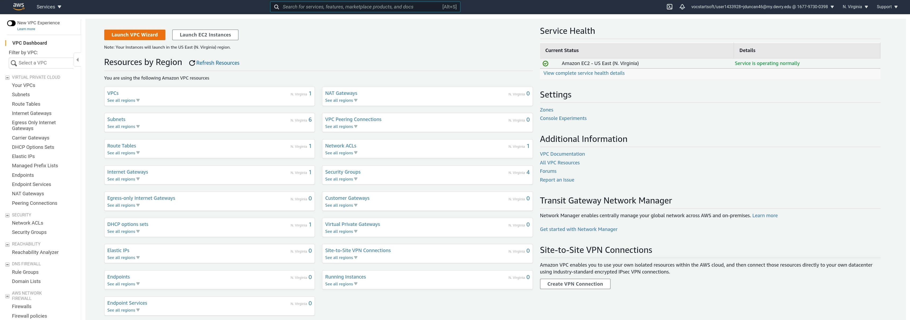
Section 2: Virtual Networks
After clicking on vpc, I will select Launch VPC Wizard.

Slide 41
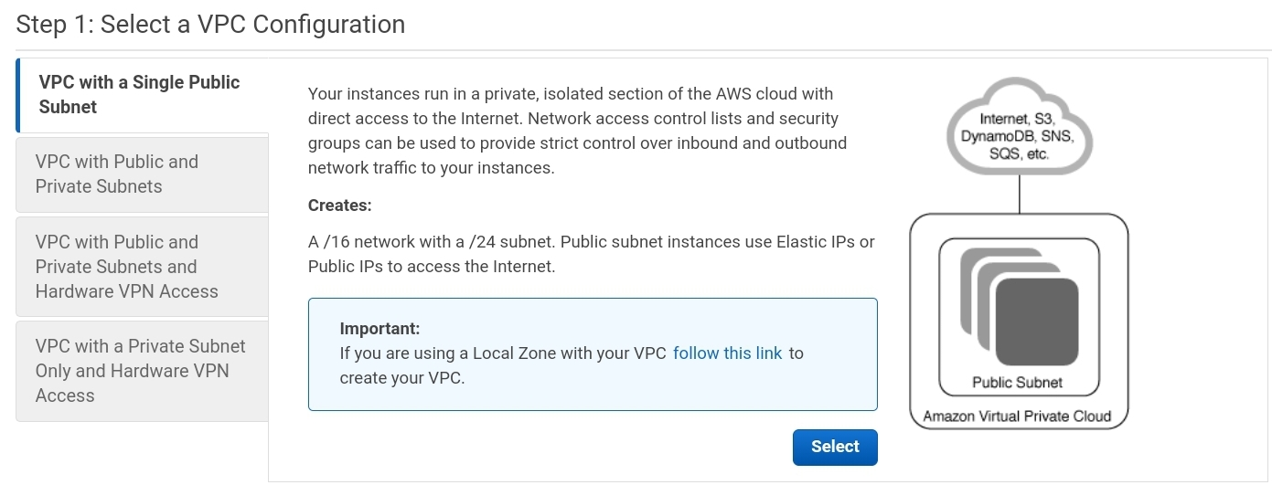
Section 2: Virtual Networks
In the VPC wizard I make sure VPC with a Single Public Subnet is selected, then I click on Select.

Slide 42
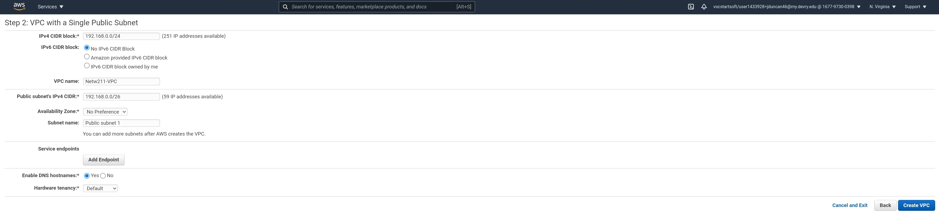
Section 2: Virtual Networks
Next I type in “192.168.0.0/24” for the IPv4 CIDR block, “Netw211-VPC” for VPC name, “192.168.0.0/26” for Public subnet’s CIDR, and “Public subnet 1” for Subnet name.

Slide 43
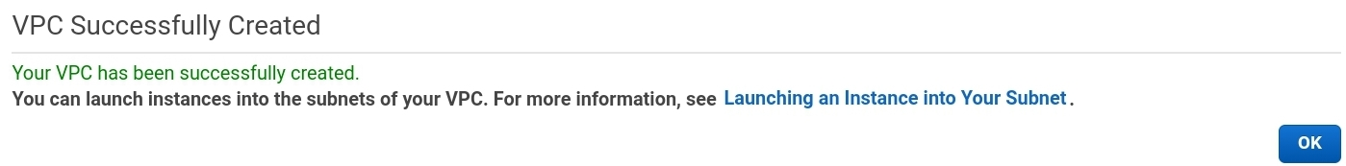
Section 2: Virtual Networks
I’m notified that my VPC was successfully created. I click on OK.

Slide 44
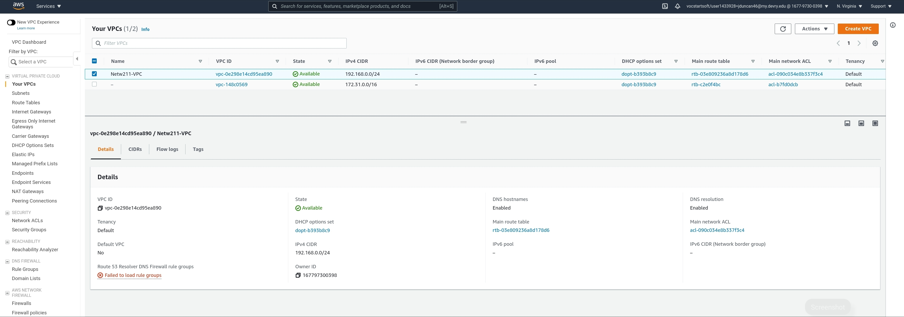
Section 2: Virtual Networks
In the Your VPCs, section I can see the details of my newly created VPC, to include the VPC ID.

Slide 45
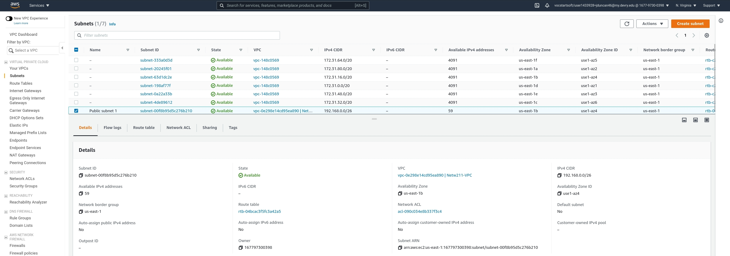
Section 2: Virtual Networks
If I click on Subnets, and select Public subnet 1 and look in the Details section, I can see the available IPv4 addresses in my subnet.

Slide 46
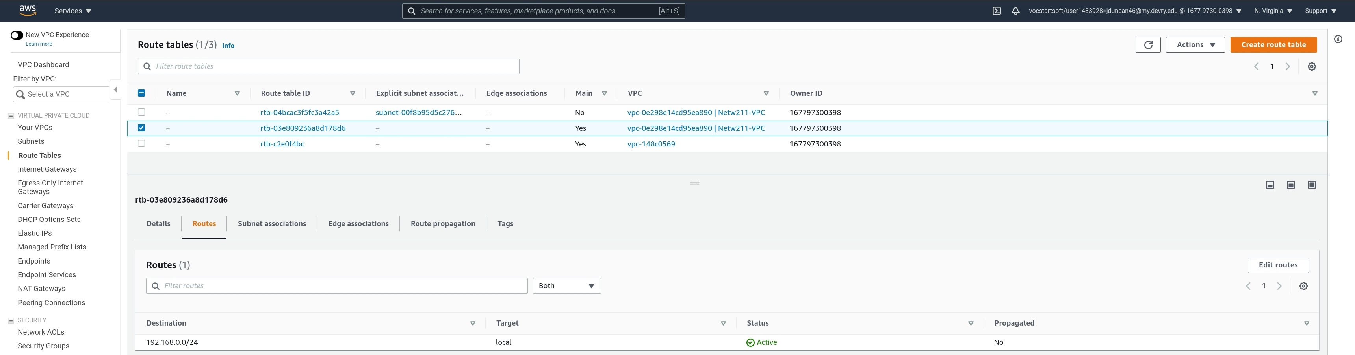
Section 2: Virtual Networks
Next I click on Route Tables. I can see the main route table for my VPC only contains a local route with no route to the internet.

Slide 47
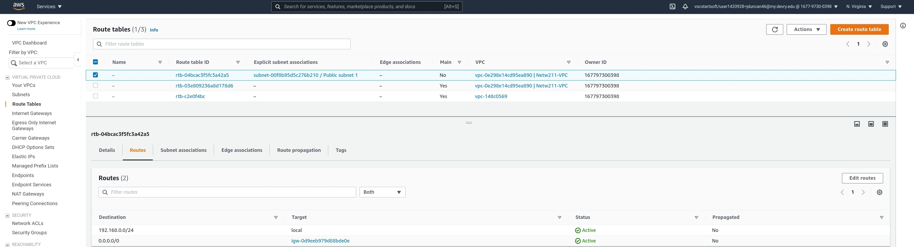
Section 2: Virtual Networks
Next I select the route table with the subnet Public subnet 1. I can see it has a route to the internet (0.0.0.0/0).

Slide 48
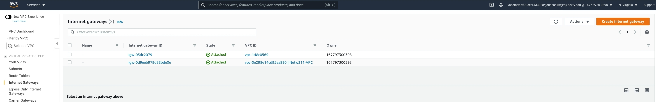
Section 2: Virtual Networks
Next I click on Internet Gateways, and I can see the internet gateway is attached to my VPC.

Slide 49
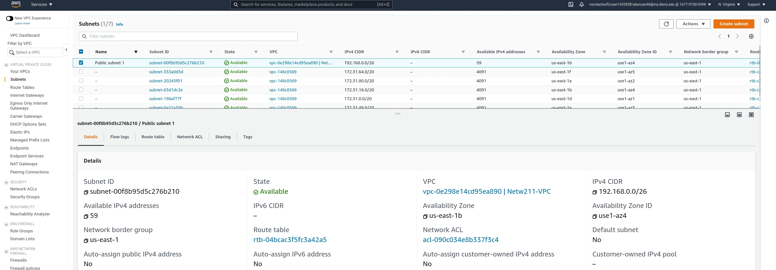
Section 2: Virtual Networks
I want to create a second subnet in a different Availability Zone (AZ) from my first subnet to provide High Availability (HA). I click on Subnets, select Public Subnet 1 and take note of it’s AZ. Next I click on Create subnet.
3
2
1

Slide 50
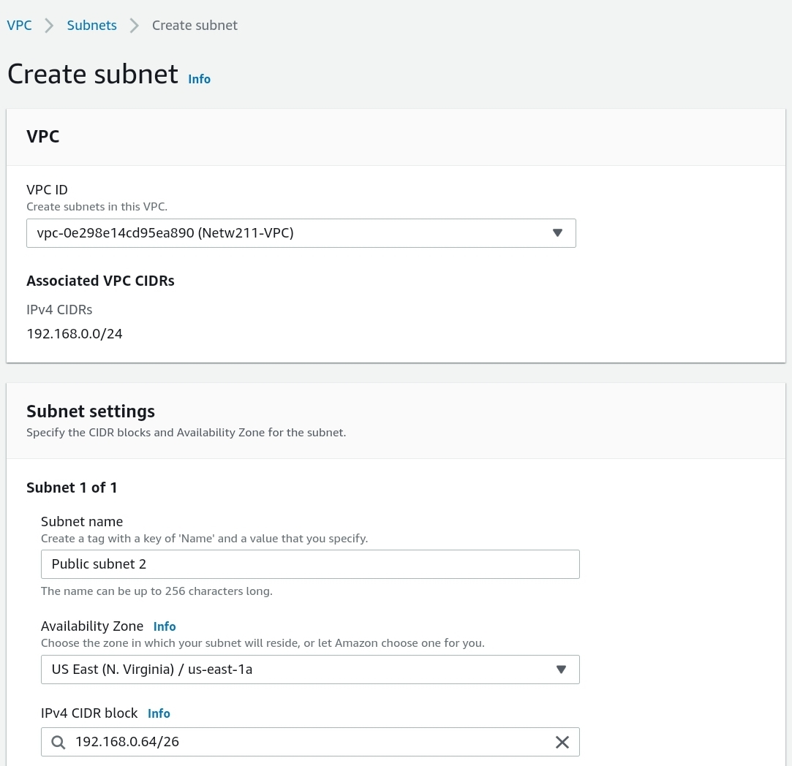
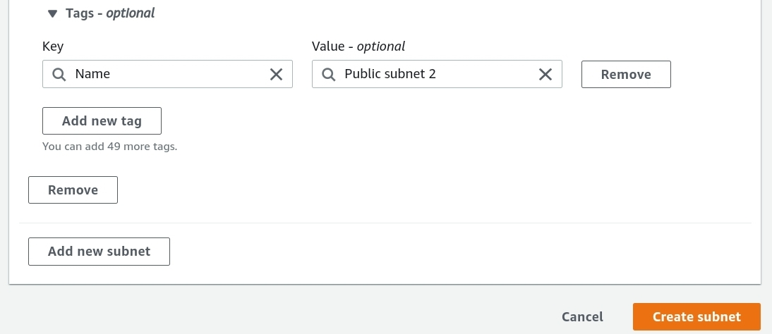
Section 2: Virtual Networks
Next I select Netw211-VPC for the VPC ID.
Type Public subnet 2 for Subnet name.
Type 192.168.0.0/26 for IPv4 CIDR block.
Select a different zone from your first subnet for Availability Zone.
Next click on Create subnet.

Slide 51
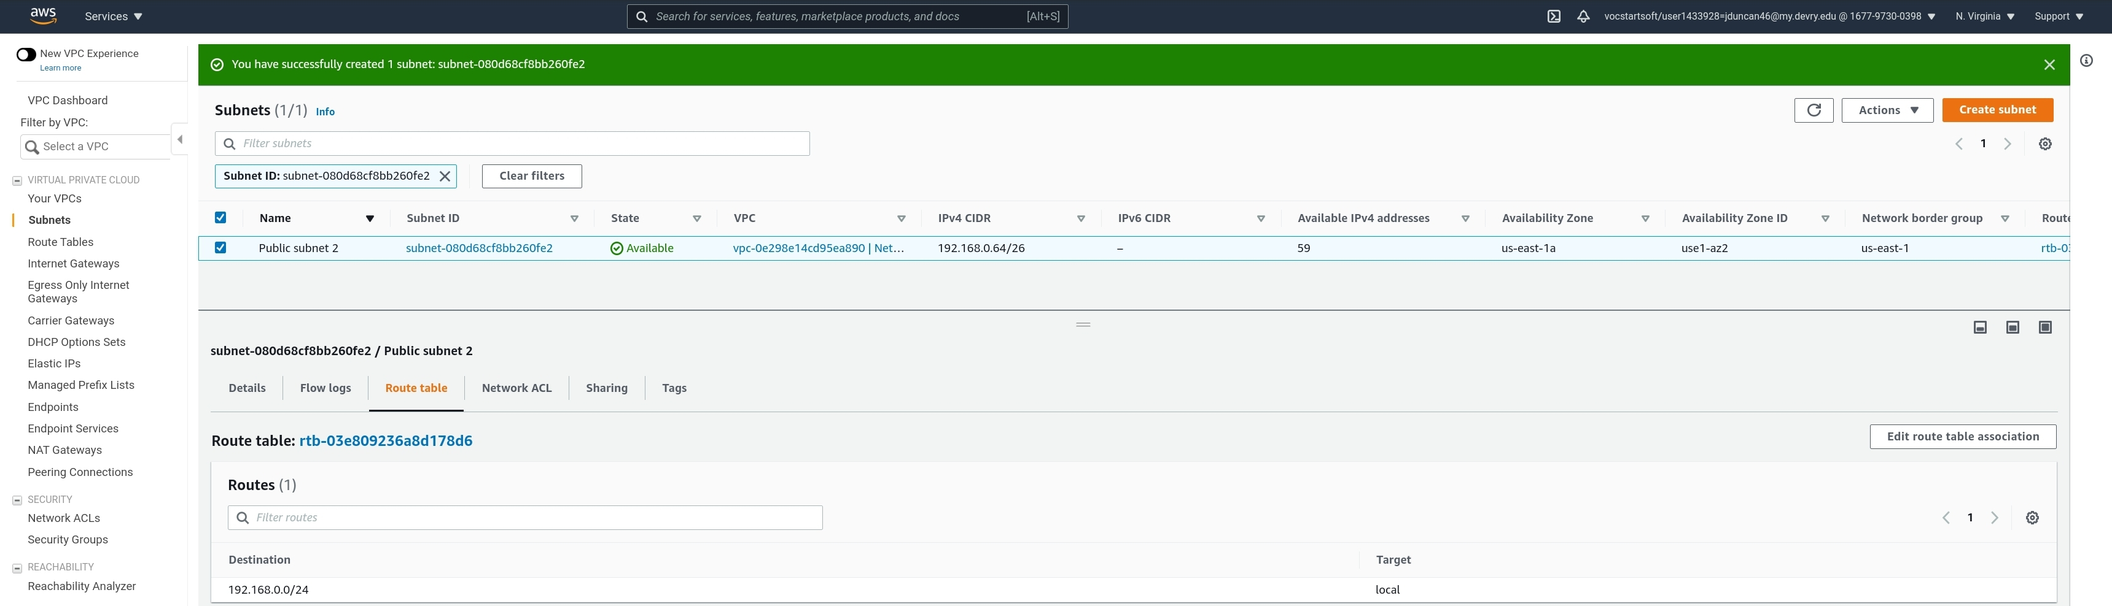
Section 2: Virtual Networks
Next I type I’m notified that I’ve successfully created a subnet. I select Public subnet 2 and notice it does not have access to the internet under destination. I want to change that so I click on Edit route table association.

Slide 52
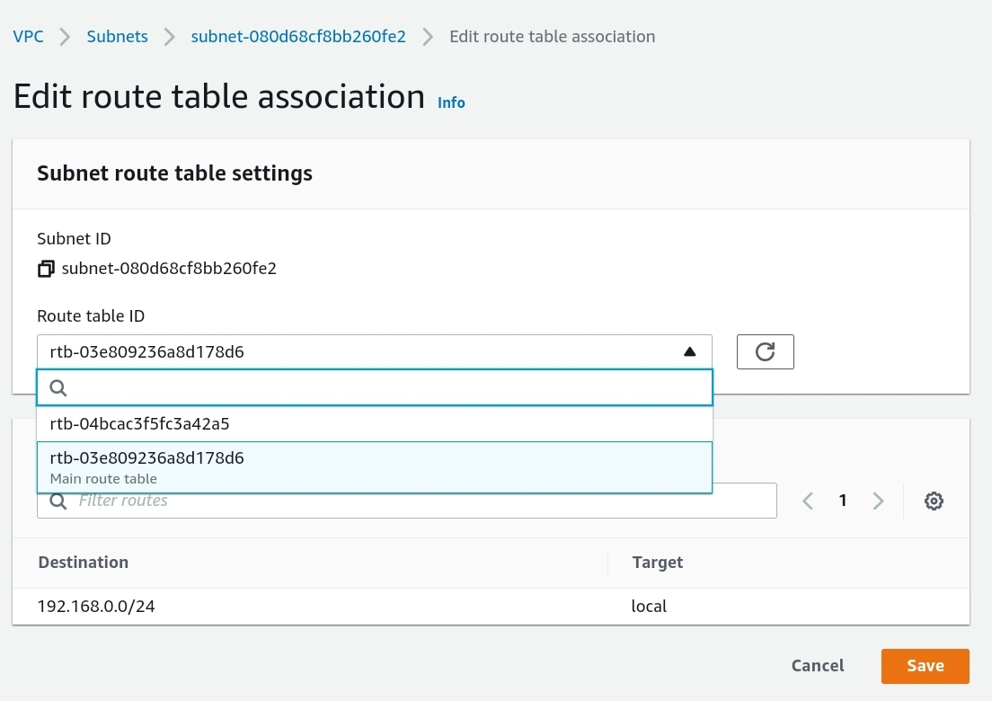
Section 2: Virtual Networks
Under Route table ID, select the routing table that Public subnet 1 is using.

Slide 53
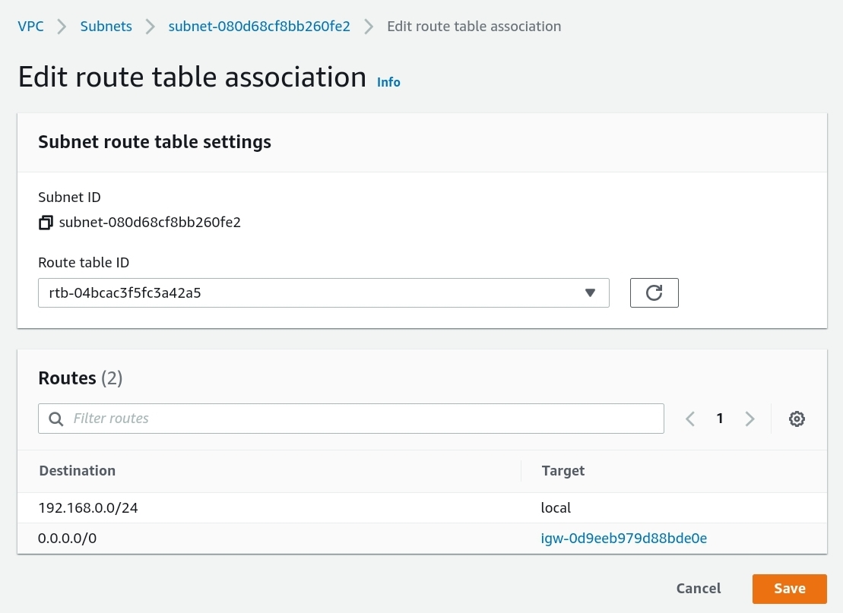
Section 2: Virtual Networks
I now have the same destinations as Public subnet 1. I click on Save.

Slide 54
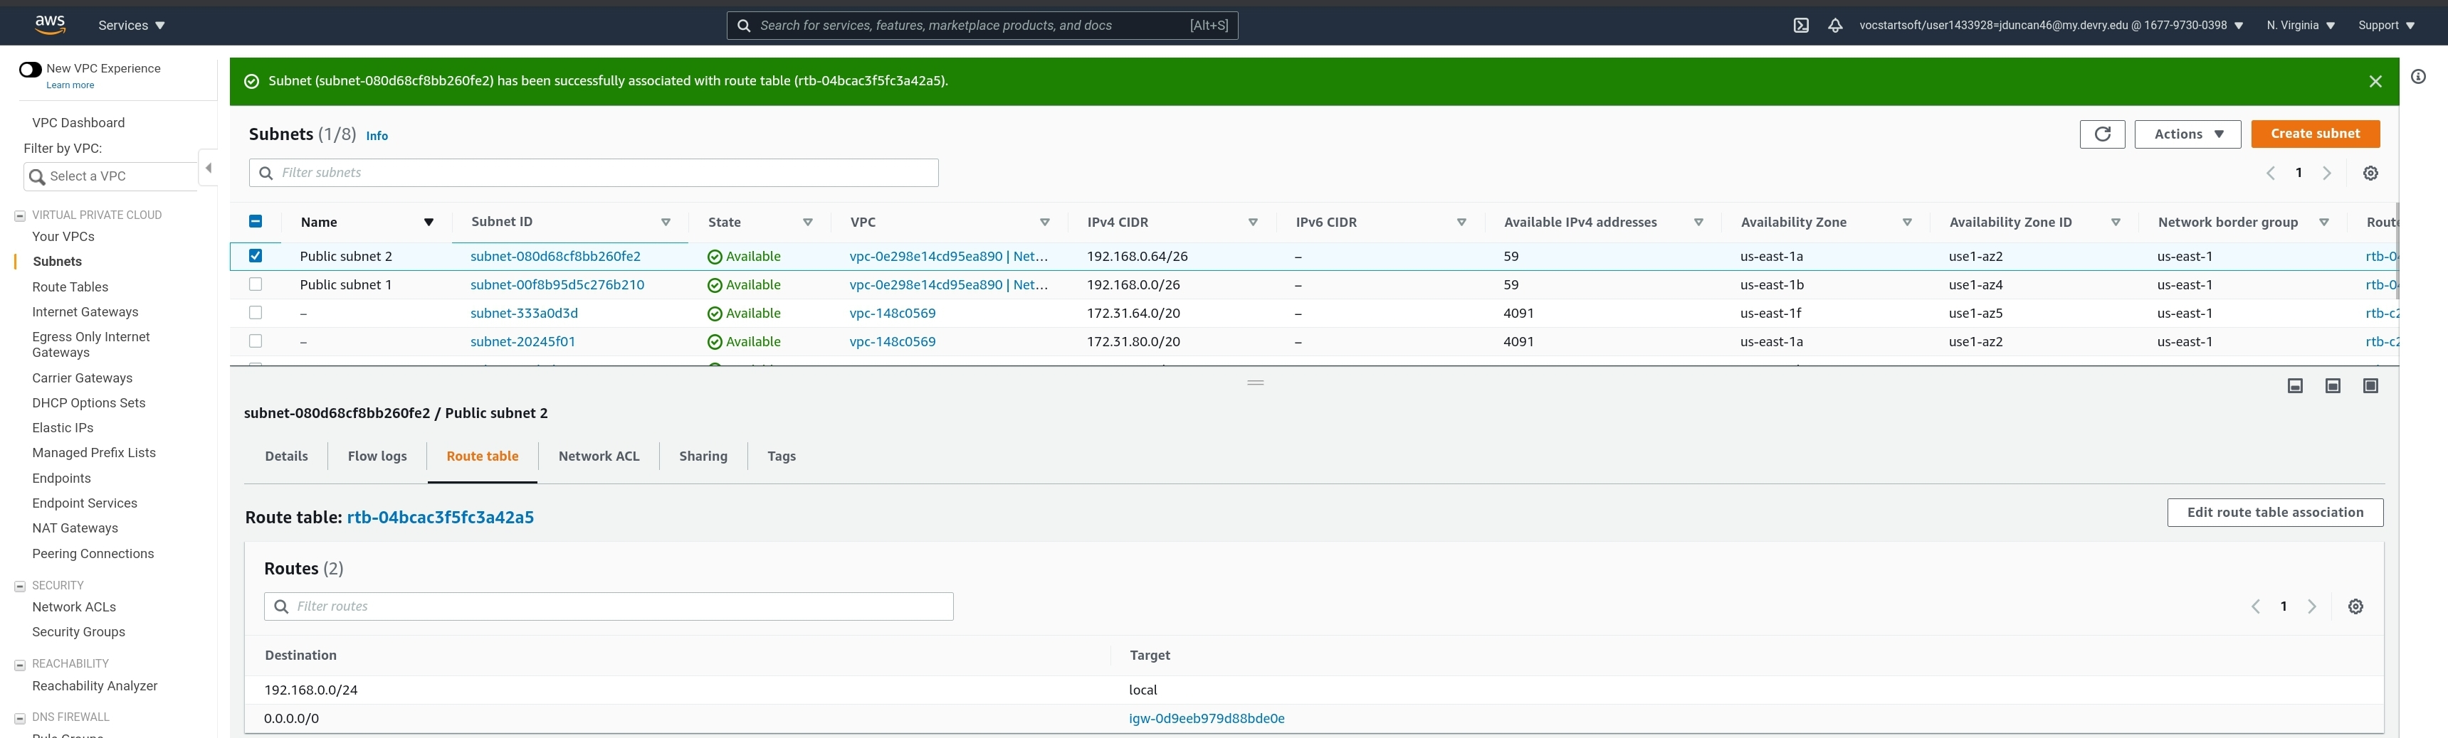
Section 2: Virtual Networks
I get a notificaton that my subnet has been successfully associated with the routing table, and I can verify by looking at Public subnet 2’s Route table.

Slide 55
Section 2: Virtual Networks
Challenge Question:
With a /26 network prefix, how many usable IPv4 addresses are there?
Why is the number of available IPv4 addresses HERE shown as 59?

Slide 56
ANSWER:
Section 2: Virtual Networks
There are 59 usable IPv4 addresses out of 64 in the segment. There are only 59 of the 64 available due to 5 of the addresses being reserved. The first four are reserved for:
1. Network Address.
2. Reserved for AWS for VPC Router.
3. Reserved for AWS.
4. Reserved for AWS future use.
5. The final and fifth address is reserved for Network Broadcast.
Reference:
https://docs.aws.amazon.com/vpc/latest/userguide/VPC_Subnets.html#vpc-sizing-ipv4

Slide 57
Section 2: Virtual Networks
Challenge Question:
What’s the role of an Internet Gateway?

Slide 58
ANSWER:
Section 2: Virtual Networks
The role of an Internet Gateway is to enable communication between the VPC and the Internet.
It serves 2 purposes in which it provides communication between the VPC and the Inernet, and to perform network address translation (NAT) for assigned public IPv4 addresses.
Reference:
https://docs.aws.amazon.com/vpc/latest/userguide/VPC_Internet_Gateway.html

Slide 59
SECTION 3
vm security: Securing aws EC2 with Security groups
In section three of my project I am:
LAUNching a ec2 instance.
Setting up a security group.
Remotely testing my ec2 instance with a security group
Terminating all the created resources.

Slide 60
Career Skills obtained
Section 3: VM Security
experience with setting up and terminating security groups.
Knowledge to remotely test Virtual machines with security groups.
Ability to troubleshoot security groups.

Slide 61
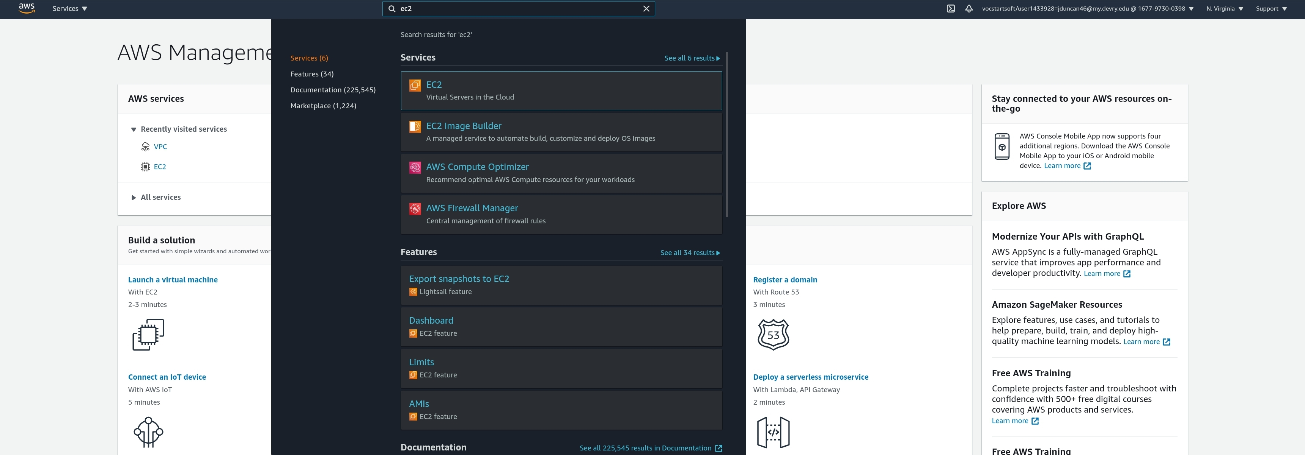
Section 3: VM Security
In the AWS Management Console, I will type EC2 in the top search bar and select EC2 from the drop-down menu.

Slide 62
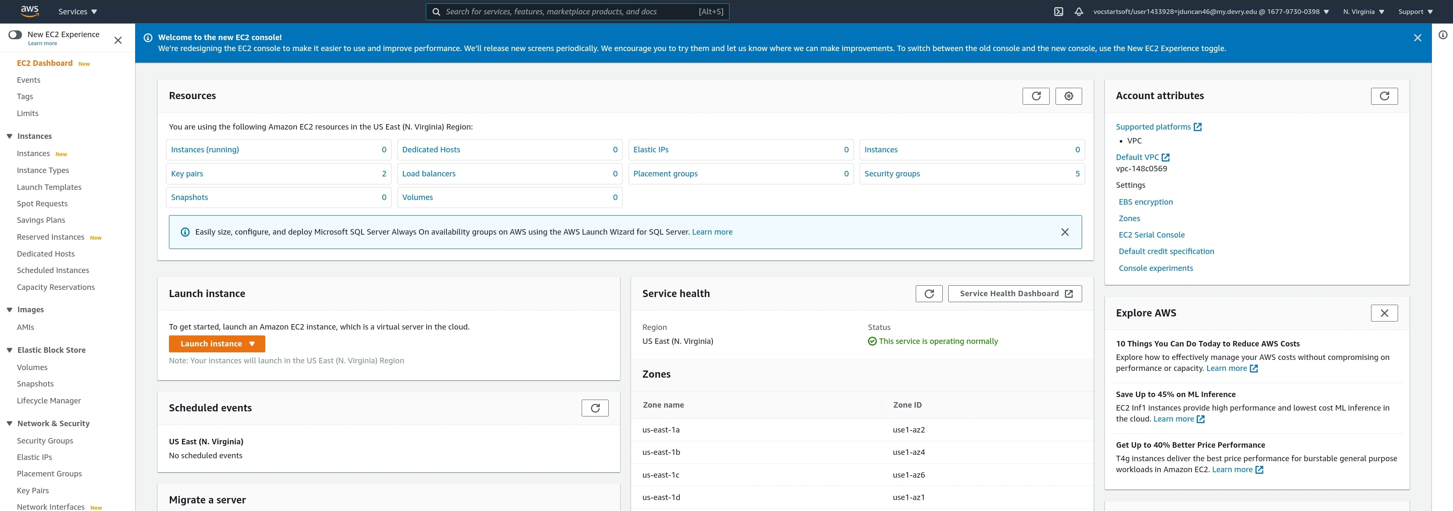
Section 3: VM Security
Once I’m on the EC2 console, I will select Instances on the left panel.

Slide 63
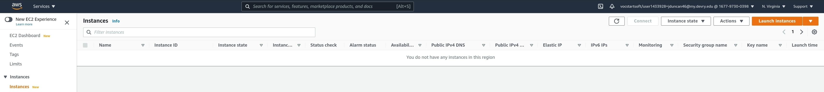
Section 3: VM Security
Next I will select Launch instances.

Slide 64
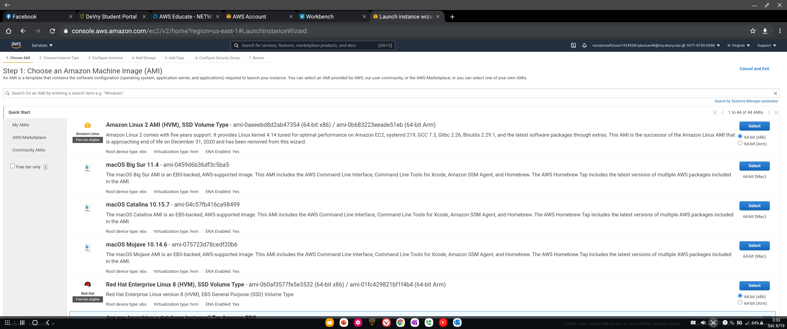
Section 3: VM Security
I want to start another EC2 instance, so I select the Amazon Linux 2 AMI from before.

Slide 65
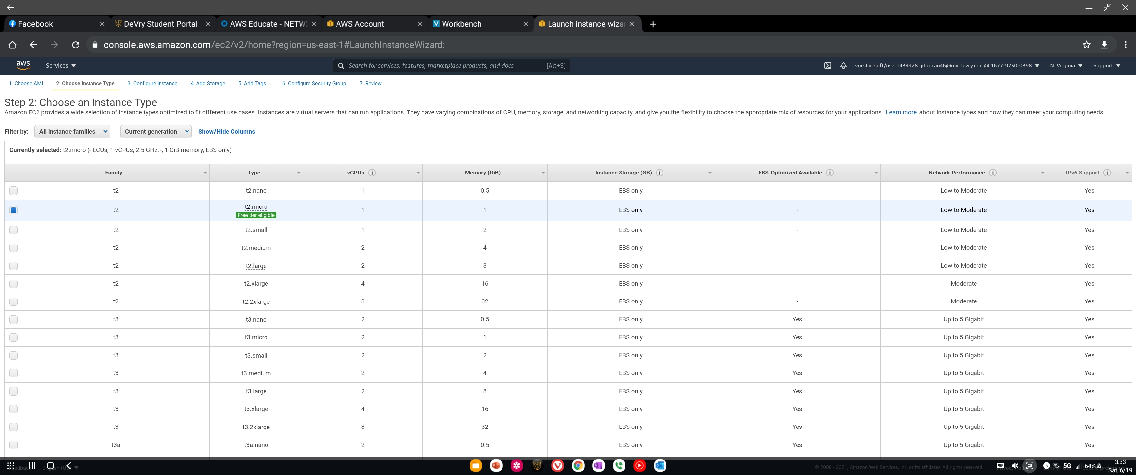
Section 3: VM Security
I select t2.micro again.

Slide 66

Section 3: VM Security
Under Configure Instance, I select Netw211-VPC for Network, Public subnet 1 for Subnet, and Enable for Auto-assign Public IP.

Slide 67

Section 3: VM Security
Under Add Tags, I add a tag with Name for the Key and netw211-project-ec2 as the Value.

Slide 68


Section 3: VM Security
Under Review I click on Launch.

Slide 69

Section 3: VM Security
I select Create a new key pair and under Key pair name I typed in “netw211-final-project-ec2-1”. Next I select Download Key Pair which prompts me if I want to download the Pem key file called “netw211-final-project-ec2-1.pem”. I cIick Download, then Launch instances.
1
2
3
4

Slide 70

Section 3: VM Security
After clicking on Launch Instances, I’m notified my instance is now launching. I will select View Instances.

Slide 71

Section 3: VM Security
In Instances, I make sure I have selected my EC2 instance. From there I take note of the Public and private IP addresses, and the VPC ID of my instance.

Slide 72

Section 3: VM Security
I connect remotely to my EC2 instance with Secure Shell (SSH). I use the Android App Termius again for this purpose, making sure to use the correct PEM file I downloaded, username, and Public DNS/IP Address from my instance.
User Name
Private IP

Slide 73

Section 3: VM Security
After successfully connecting to my instance with SSH, I will select Security. In the Instances page for netw211-project-ec2. I have 1 security group associated with my instance called launch-wizard-4. It currently has port 22 open (SSH).
Port 22 = SSH

Slide 74

Section 3: VM Security
I try to ping my instance, but I’m unsuccessful because the security group Launch-wizard-4 is preventing me from pinging netw211-project-ec2.

Slide 75

Section 3: VM Security
In order to enable pinging, I’m going to creat another security group. I select Create security group in the Security Groups page.

Slide 76


Section 3: VM Security
I type “netw211-allow-ping” for Security group name, and “Allow ping to instances” for Description. I select Netw211-VPC for my VPC. I click on Add rule, select All ICMP – IPv4 for Type, and Anywhere for Source. I click on Create security group once complete.

Slide 77

Section 3: VM Security
I can now see my newly created security group netw211-allow-ping with it’s description and rules.

Slide 78

Section 3: VM Security
I now want to apply my security group to my instance. I select my instance, click on Actions, then Security, then Change security groups.
1
3
2

Slide 79

Section 3: VM Security
I want to remove the default security group launch-wizard-4. I click on remove next to that security group.

Slide 80

Section 3: VM Security
Once I remove the default security group, the SSH connection I established earlier with my instance was disconnected. This is because Port 22 is no longer has an open port to allow SSH communication.

Slide 81

Section 3: VM Security
Next, I select the security group I created earlier (netw211-allow-ping), and click on Add security group.

Slide 82

Section 3: VM Security
My security group now shows up under the associated security groups for my instance. I click on Save.

Slide 83

Section 3: VM Security
In the Instances page, under Security, I can see my newly added security group and it’s inbound rules.

Slide 84

Section 3: VM Security
To test to see if my security group is working, I ping my instance again. This time it’s a success. This is because I enabled ICMP in the security group, which is the protocol that allows 2 machines to ping each other.

Slide 85

Section 3: VM Security
Now that I have successfully created and tested my security group on my EC2 instance, I want to terminate it. I select Instance state, and then Terminate instance.

Slide 86

Section 3: VM Security
Next I click on Terminate.

Slide 87

Section 3: VM Security
Once I click Terminate, I’m notified my instance was successfully terminated and my instance state will change to Terminated.

Slide 88

Section 3: VM Security
Next I want to delete my key pairs I have created. I click on Key Pairs on the left menu, then select the key pair I created. I click on Actions, then Delete.

Slide 89

Section 3: VM Security
The mext page asks me to confirm my request to delete the key pair. I type in “delete”, then click on delete to confirm.

Slide 90

Section 3: VM Security
Next I want to remove the subnets I created earlier in the previous section. I select Services at the top left menu, and click on VPC under Recently Visited.

Slide 91

Section 3: VM Security
I make sure I’m on the Your VPCs page, select Netw211-VPC, click on Actions, then select Delete VPC.

Slide 92

Section 3: VM Security
On the next page I type in “delete” and click on Delete to confirm I want to delete my VPC with my 2 subnets I created earlier.

Slide 93

Section 3: VM Security
I am then notified I have successfully deleted my VPC.

Slide 94
Section 3: VM Security
Challenge Question:
After completing Part 2, could you connect to the EC2 instance via an SSH client on your computer?
Why or why not?

Slide 95
ANSWER:
Section 3: VM Security
No, you could not connect due to Port 22 being closed after removing default security group. To connect via SSH you would have to open up port 22 for incoming traffic in the drop-down section in the new security group you created.

Slide 96
SECTION 4
cloud storage: AWS Simple Cloud Storage (S3)
In section four of my project I am:
Creating a s3 Bucket.
Uploading a file to s3 bucket.
Changing file and bucket permissions.
Removing file from s3 bucket.

Slide 97
Career Skills obtained
Section 4: Cloud Storage
experience with setting up and terminating s3 buckets.
experience with uploading files to AWS buckets.
Experience with managing security permissions of s3 buckets and files.
Ability to troubleshoot s3 buckets.
Ability to remove files and terminate buckets.

Slide 98

Section 4: Cloud Storage
AWS Simple Cloud Storage (S3) is an object storage service that offers scalability, data availability, security, and performance. S3 can be used for a multitude of business sizes and purposes. To get to S3, I type “S3” in the top search bar, then click on S3.

Slide 99

Section 4: Cloud Storage
I click on Create bucket in the Buckets section of the S3 console.

Slide 100


Section 4: Cloud Storage
I type in “netw211-project-bucket-jd46” for Bucket name, and click on Create bucket.

Slide 101

Section 4: Cloud Storage
I’m notified that I have successfully created a bucket, and it is shown now under Buckets.
I click on my bucket netw211-project-bucketjd46 as shown below.

Slide 102

Section 4: Cloud Storage
If I select Properties next under my bucket I can see an overview of information.

Slide 103

Section 4: Cloud Storage
I want to use my bucket to store data, so I select Objects, then click on Upload.

Slide 104


Section 4: Cloud Storage
I’m taken to an upload screen. I click on Add files and select a picture of Yoda to upload.

Slide 105

Section 4: Cloud Storage
The picture I selected is now showing up under Files and Folders. I click on Upload to complete the process.

Slide 106

Section 4: Cloud Storage
Im notified my upload was successful at the top of the screen, and the file shows up in the Files and folder section.

Slide 107

Section 4: Cloud Storage
If I click on the file name, I’m taken to the file’s properties. I can see the URL for the picture under Object URL.

Slide 108

Section 4: Cloud Storage
If I try to access the file from the URL, I’m taken to an Access Denied screen. This is because I have not given public access to this file yet.

Slide 109

Section 4: Cloud Storage
I can verify this by going to the Permissions section of the file. I can see there is no public access.

Slide 110

Section 4: Cloud Storage
Currently the bucket I have created has defaulted to blocking all public access to it’s files. In order to change this I need to go to the bucket’s Permission section, and click on Edit in the bucket settings.

Slide 111

Section 4: Cloud Storage
I uncheck the box to Block all public access, and make sure the boxes under it are unchecked as well. I click on Save changes.

Slide 112

Section 4: Cloud Storage
To make changes to public access I have to confirm it by typing “confirm”, and then clicking Confirm.

Slide 113

Section 4: Cloud Storage
I’m now notified I have successefully edited the public access settings. I can now see the public access block is off too.

Slide 114

Section 4: Cloud Storage
I now need to make the file in my bucket public. I select the file, click on Actions and then Make public.

Slide 115

Section 4: Cloud Storage
Next I click on Make public in the Make public window.

Slide 116

Section 4: Cloud Storage
I’m notified I have successefully edited public access.

Slide 117

Section 4: Cloud Storage
I can now see that the file I uploaded has read access for everyone now under the files Permissions.

Slide 118

Section 4: Cloud Storage
I go back to file properties and click on the file’s Object URL.

Slide 119

Section 4: Cloud Storage
I can now view the file publicly from the cloud.

Slide 120

Section 4: Cloud Storage
In order to delete the file I uploaded, I go to the bucket’s Objects section, select the file, and click on Delete.

Slide 121

Section 4: Cloud Storage
Next I have to type in “permanently delete” an dclick on Delete objects to confirm.

Slide 122

Section 4: Cloud Storage
I’m notified I have successfully deleted the object.

Slide 123

Section 4: Cloud Storage
Now to delete the bucket I created earlier I need to select it in the Buckets section, and click on Delete.

Slide 124

Section 4: Cloud Storage
I need to type in the bucket name, and click on Delete bucket to confirm.

Slide 125

Section 4: Cloud Storage
I’m notified at the top that my bucket has been deleted successfully.

Slide 126
Section 4: Cloud Storage
Challenge Question:
What does the default encryption do?

Slide 127
ANSWER:
Section 4: Cloud Storage
It allows you to set the default encryption characteristics when new objects are stored into the bucket. The encryption methods are Amazon S3-managed keys (SSE-S3) or AWS KMS key stored in AWS Key Management Service (AWS KMS) (SSE-KMS). The objects are encrypted on the server side
References:
https://docs.aws.amazon.com/AmazonS3/latest/userguide/bucket-encryption.html

Slide 128
Section 4: Cloud Storage
Challenge Question:
If you only change the bucket permissions, instead of both bucket and file permissions, would you still have public access to that file?
Why or why not?

Slide 129
ANSWER:
No, you would not. If you try to access the file publicly after changing permissions on your bucket you will still get an access denied message. You have to go to the specific file and give it public access too before you can publicly view it.
Section 4: Cloud Storage

Slide 130
SECTION 5
cloud monitoring: AWS Simple Notification Services (SNS) and cloudwatch
In section four of my project I am:
Launching an EC2 instance.
Setting up sns notifications and subscription.
Setting up a cloudwatch alarm.
Testing the Cloudwatch alarm.
Removing the cloud resources.

Slide 131
Career Skills obtained
Section 5: Cloud Monitoring
experience with Amazon Simple notification service.
Experience with Amazon CLoudWatch
Knowledge to manage cloudwatch alarms.
Ability to publish messages out to customers.

Slide 132

Section 5: Cloud Monitoring
In the AWS Management Console, I click on EC2 in the AWS services section under Recently visited services.

Slide 133

Section 5: Cloud Monitoring
Now that I’m in the EC2 console, I click on Launch instance to begin creating aother VM.

Slide 134

Section 5: Cloud Monitoring
Once again I’ll be using Amazon Linux 2 AMI as my selection for an Amazon Machine Image (AMI).

Slide 135

Section 5: Cloud Monitoring
I select t2.micro again for my instance type.

Slide 136

Section 5: Cloud Monitoring
Next, I click on Add tag in the Add Tags section.

Slide 137

Section 5: Cloud Monitoring
I type in “Name” for the Key, and “netw211-project-ec2” for the Value.

Slide 138

Section 5: Cloud Monitoring
In the Configuration Security Group section I click on Add Rule.

Slide 139

Section 5: Cloud Monitoring
I select All ICMP – IPv4 for Type, and type in “0.0.0.0/0” as shown below.

Slide 140

Section 5: Cloud Monitoring
Next, in the Review section I click on Launch.

Slide 141

Section 5: Cloud Monitoring
This time I do not want to use a Key pair, so I select Proceed without a key pair, check the box that I acknowledge, and click on Launch Instances.

Slide 142

Section 5: Cloud Monitoring
I’m notified my instance is launching. I click View Instances to continue.

Slide 143

Section 5: Cloud Monitoring
In the Instances section under Details, I can see the IP addresses of my created VM.

Slide 144

Section 5: Cloud Monitoring
I ping the public IP address of my instance from my terminal to verify it has access to the internet.

Slide 145

Section 5: Cloud Monitoring
Next I want to set up Simple Notification Service (SNS). SNS allows me to fanout impotant messages to a large number of subscribers.
I type in “sns” in the search bar at the top, and click on Simple Notification Service.

Slide 146

Section 5: Cloud Monitoring
In the Topics section, I click on Create topic.

Slide 147

Section 5: Cloud Monitoring
I type “Netw211PingTopic” for the Name, “Netw211 Ping Attempt” for Display name, and click on Create topic.

Slide 148

Section 5: Cloud Monitoring
I’m notified my topic was created successfully. Next I click on Create subscription.

Slide 149

Section 5: Cloud Monitoring
I select Netw211PingTopic for Topic ARN, Email for Protocol, and my email for Endpoint. I click on Create subscription to continue.

Slide 150

Section 5: Cloud Monitoring
I’m notified my Subscription was created Successfully at the top. In the details it shows my subscription is pending confirmation now.

Slide 151


Section 5: Cloud Monitoring
I’m sent an email requesting confirmation of my subscription. I click on Confirm subscription and then I’m taken to an AWS webpage that informs me my subscription is confirmed.

Slide 152

Section 5: Cloud Monitoring
I can see my topic in the Topics section now. I want to sent out a message from my created topic, so I select Netw211PingTopic, and click on Publish message.

Slide 153


Section 5: Cloud Monitoring
I type in “Netw211 Test Message” for the Subject, type a test message under Message body to send to the endpoint, and click on Publish message.

Slide 154

Section 5: Cloud Monitoring
Im notified at the top that my message was published successfully.

Slide 155

Section 5: Cloud Monitoring
When I check my email, I can see I have the message in my inbox.

Slide 156

Section 5: Cloud Monitoring
Next I want to set up Cloudwatch. Some of Cloudwatch’s features include the ability to set alarms, visualize logs and metrics side by side, take automated actions, and troubleshoot issues.
I type in “cloudwatch” in the top search bar, and click on Cloudwatch.

Slide 157

Section 5: Cloud Monitoring
I’m taken to the CloudWatch console. I click on Metrics on the left panel, and then EC2 under All Metrics.

Slide 158

Section 5: Cloud Monitoring
Next, I click on Per-Instance Metrics.

Slide 159

Section 5: Cloud Monitoring
I want to observe the network input to my VM instance, so I select netw211-project-ec2 with the NetworkIn metric name. I select 1h for the graph.

Slide 160

Section 5: Cloud Monitoring
Next, I select Graphed metrics. I can see NetworkIn in this section now. I make sure it’s selected then I click on the Create alarm icon as shown below under Actions.

Slide 161


Section 5: Cloud Monitoring
I select 1 minute for the Period, select Greater/Equal for the alarm condition, type “1000” for threshold value, and click Next.

Slide 162


Section 5: Cloud Monitoring
In the Notification page, I select Netw211PingTopic as the destination for my alarm then click Next.

Slide 163

Section 5: Cloud Monitoring
I type “Netw211EC2NetworkIn” for the Alarm name, then click on Next.

Slide 164


Section 5: Cloud Monitoring
Next, in the Preview and Create page I can see the details of my alarm. I click on Create alarm.

Slide 165

Section 5: Cloud Monitoring
I’m notified I have successfully created the alarm, and I can see it now in the Alarms section. Next I click on my alarm: Netw211EC2NetworkIn.

Slide 166

Section 5: Cloud Monitoring
Next I click on View in metrics at the top right of the page.

Slide 167

Section 5: Cloud Monitoring
I can see a visual representation of network activity of my instance from here.

Slide 168


Section 5: Cloud Monitoring
I want to test the alarm and monitoring of my instance so I ping it with 1500 bytes of data continuously and observe the results. I can see the graph rise up after a few minutes.

Slide 169

Section 5: Cloud Monitoring
I’m also sent an alarm email notification from the alarm Netw211EC2NetworkIn.

Slide 170

Section 5: Cloud Monitoring
Now I want to observe Cloudwatch from my EC2 console. I click on Services at the top, and then click on EC2 under Recently visited.

Slide 171

Section 5: Cloud Monitoring
I can observe a multitude of monitoring metrics of my instance from here.

Slide 172

Section 5: Cloud Monitoring
Now its time to remove all the resources I have created. I start with stopping my terminal from pinging my VM by pressing Ctrl+C.

Slide 173

Section 5: Cloud Monitoring
Next I click on Services, and then click on CloudWatch under the Recently visited section.

Slide 174

Section 5: Cloud Monitoring
I select the alarm I created, and click on Delete from the Actions menu.

Slide 175

Section 5: Cloud Monitoring
I’m notified my alarm was successfully deleted.

Slide 176

Section 5: Cloud Monitoring
Next I click on Services, and then click on Simple Notification Services under the Recently visited section.

Slide 177

Section 5: Cloud Monitoring
I select the topic I created and click on Delete.

Slide 178

Section 5: Cloud Monitoring
I type “delete me” in the confirmation box, and click on Delete.

Slide 179

Section 5: Cloud Monitoring
I’m notified my topic was successfully deleted.

Slide 180
Section 5: Cloud Monitoring
Next I click on Services, and then click on EC2 under the Recently visited section.

Slide 181

Section 5: Cloud Monitoring
I select the VM I created, and click on Terminate instance in the Instance state menu.

Slide 182

Section 5: Cloud Monitoring
I’m notified my instance was successfully terminated.

Slide 183
Section 5: Cloud Monitoring
Challenge Question:
Instead of sending an alarm out as an email, what other options are there?

Slide 184

ANSWER:
Section 5: Cloud Monitoring
Other alarm options include:
Amazon Kinesis Data Firehose, Amazon SQS, AWS Lambda, Email-JSON, HTTP, HTTPS, Platform application endpoint, and SMS

Slide 185
Conclusion
This concludes my project. I have demonstrated various cloud computing fundamentals with AWS to include:
Creating Virtual Machines (VMs) in the cloud with EC2.
VM instance security.
Building a network in AWS with a Virtual Private Cloud (VPC).
VPC configuration.
Cloud storage and security.
Cloud monitoring.

Slide 186
REFERENCES
https://aws.amazon.com/ec2/?ec2-whats-new.sort-by=item.additionalFields.postDateTime&ec2-whats-new.sort-order=desc
https://aws.amazon.com/s3/?did=ft_card&trk=ft_card
https://aws.amazon.com/sns/?whats-new-cards.sort-by=item.additionalFields.postDateTime&whats-new-cards.sort-order=desc
https://aws.amazon.com/cloudwatch/
https://docs.aws.amazon.com/AmazonS3/latest/userguide/bucket-encryption.html
https://docs.aws.amazon.com/vpc/latest/userguide/VPC_Subnets.html#vpc-sizing-ipv4
https://docs.aws.amazon.com/vpc/latest/userguide/VPC_Internet_Gateway.html
https://docs.aws.amazon.com/vpc/?id=docs_gateway
https://www.geeksforgeeks.org/uname-command-in-linux-with-examples/
https://www.geeksforgeeks.org/how-to-check-the-os-version-in-linux/

